Slide 1
Double the Muscle: Probabilities and Pedigrees

Slide 2
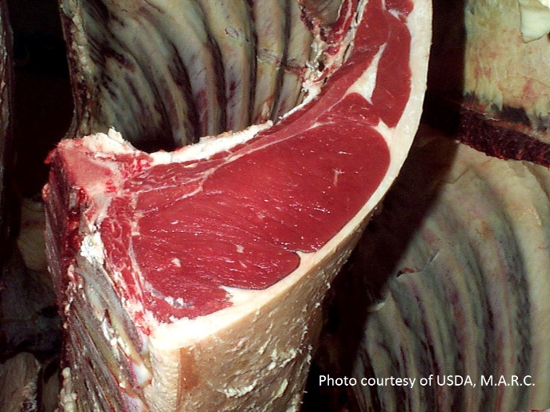
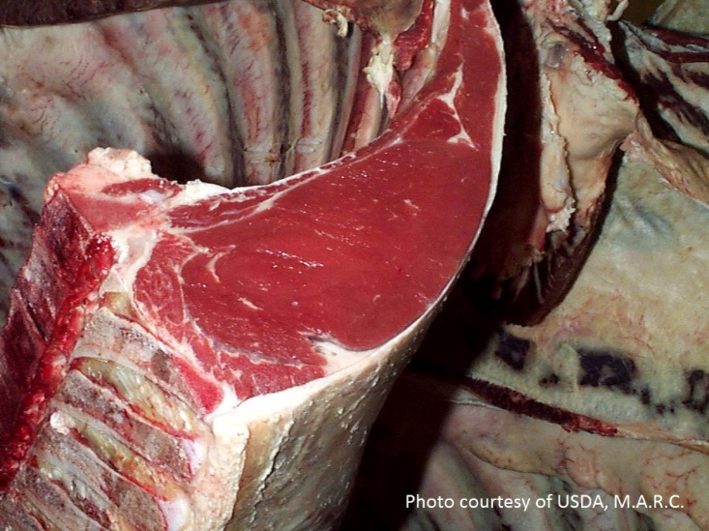
Compare meat cuts from three cattle
Notice any differences?
Notes:
What differences or similarities do you notice?
How does the meat (also called lean) compare to the fat in these cattle?
What benefits or challenges might this cause for the cattle? How about for the producer?

Slide 3
Key Vocabulary Review
After mating occurs, reproductive cells called gametes come together to form a zygote.
gamete: a mature male or female reproductive cell (sperm /pollen or egg/ ovum); contains half the total number of chromosomes in a cell; contributes one allele per gene pair to the zygote
segregation: during gamete formation, occurs when the paired alleles separate
Cells contain chromosomes.
haploid cell: cell containing one set of chromosomes (the gamete)
diploid cell: cell containing two sets of chromosomes (the zygote)
somatic cell: diploid cells that are specialized and make up the body of a multicellular organism
Chromosomes contain genes which determine an organism’s traits.
autosome: chromosome that does not determine an organism’s sex

Slide 4
Key Vocabulary Review
Genes determine traits and are made up of alleles.
allele: an alternative version of a gene
dominant allele: whenever this allele is present, the dominant trait is expressed
recessive allele: two copies of this allele must present for the recessive trait to be expressed
When describing the alleles combination of a gene, the gene is…
heterozygous: a gene pair made up of two different alleles
homozygous: a gene pair made up of two identical alleles
Organisms can be defined in terms of their genes or their outward appearance.
genotype: the allele combinations making up an organism
phenotype: the physical appearance of an organism determined by the genotype
We may be able to predict the genotype or phenotype of an organism.
Punnett square: a visual depiction of all the possible ways the alleles from two parents could combine

Slide 5
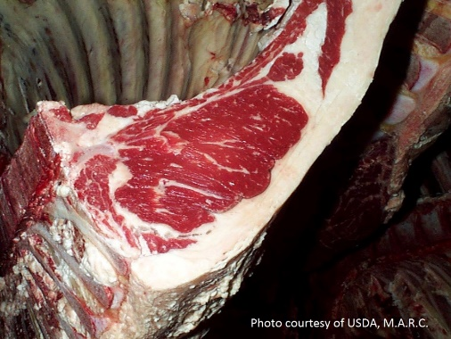
Genetic differences are responsible for this trait.
Homozygous normal muscle,
DD
Heterozygous normal muscle,
Dd
Homozygous double-muscle,
dd
The Double Muscle trait is a recessive genetic mutation which inactivates a gene that produces myostatin, a negative regulator of skeletal muscle growth. Cattle with the mutation are born with higher muscle mass.
Differences are due to….
hyperplasia: the enlargement of an organ or tissue caused by an increase in the reproduction of its cells
hypertrophy: an enlargement of an organ or tissue caused by an increase in the size of individual cells within the organ or tissue

Slide 6
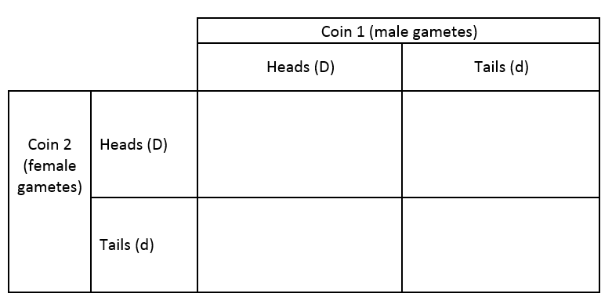
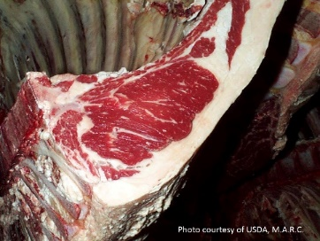
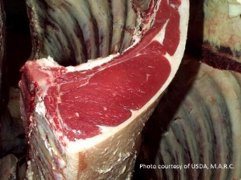
Sample Punnett Square

Slide 7
Walter’s Updated Pedigree
Alex
DD
Bella
Cody
Dora
?
Erik
Faith
Gail
Henry
Izzy
Jessy
Kirk
Lance
Missy
Omar
Nero
Penelope
Female
Male
Has double muscles
Has normal muscles

Slide 8
Genotypes of Walter’s Cattle
Alex
DD
Bella
D
Cody
D
Dora
Dd
?
d
?
dd
Erik
D
Faith
D
Gail
D
Henry
Dd
Izzy
Dd
Jessy
Dd
Kirk
Dd
Lance
dd
Missy
D
Omar
D
Nero
D
Penelope
dd
Female
Male
Has double muscles
Has normal muscles

