Slide 1
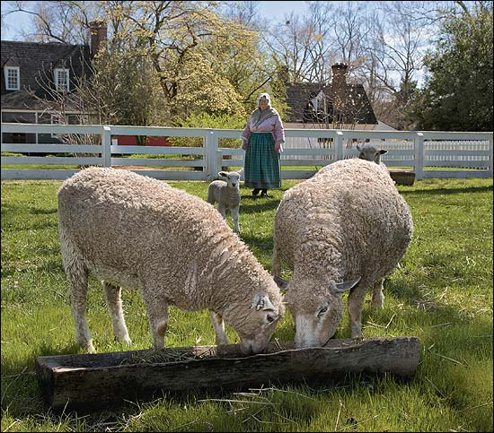
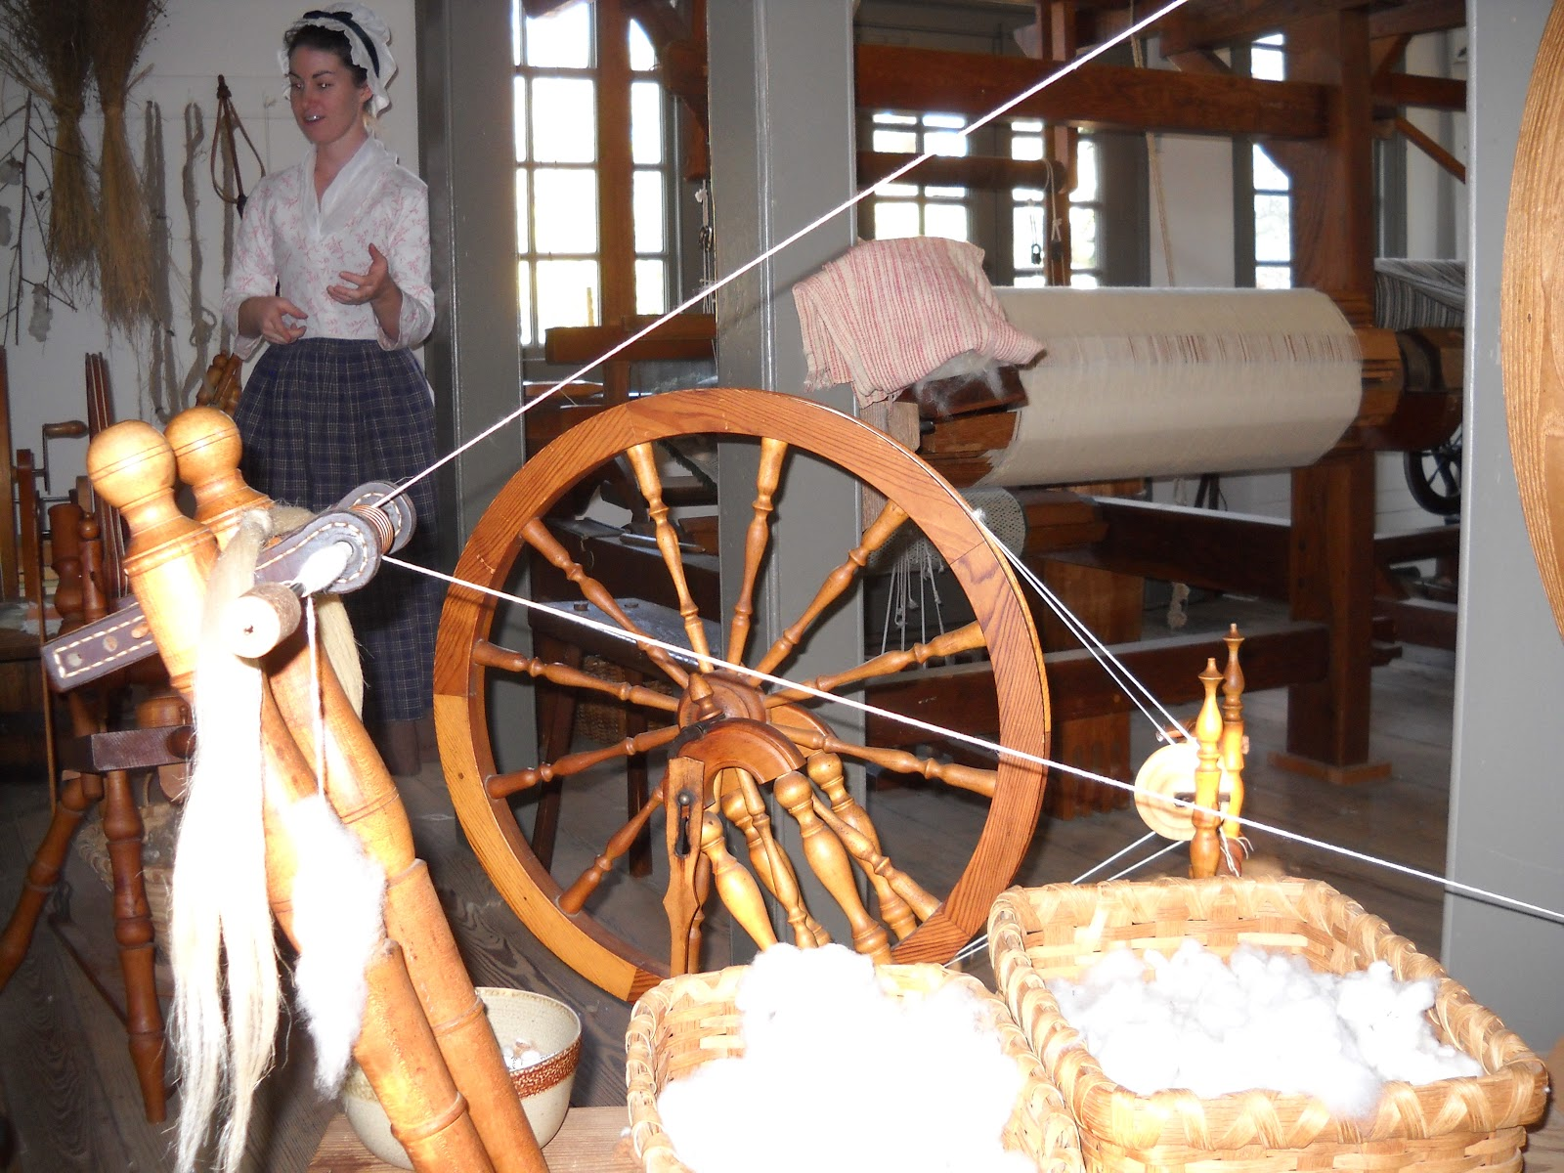
From Wool to Wheel
Wool Production in Colonial America

Slide 2
In colonial times, the price of goods from England was very expensive. The colonists wanted to produce their own clothing. Wool was one of the most common materials used by the colonists. Where does wool come from?

Slide 3
The Wool Act of 1699 was issued by the British Parliament during the reign of King William III. The Wool Act prohibited American colonists from exporting wool, wool yarn, or wool cloth outside of the colony in which it was produced. The King banned the export of sheep to the American colonies in an effort to protect England’s wool industry. Wool could only be imported into the colonies by Great Britain. The Wool Act was one of a series of acts and taxes that divided Great Britain and its colonies in America, leading to anger, resentment, and ultimately revolution in Colonial America.

Slide 4
The colonists began protesting the Wool Act by refusing to purchase or wear English textiles. It was considered a patriotic act to wear homespun clothing, which is clothing produced by the colonists. George Washington, Thomas Jefferson, and Benjamin Franklin are notable figures who wore homespun clothing as a patriotic statement of their devotion to American independence and freedom.

Slide 5
Once a year, in early spring, sheep are sheared. In colonial times, sheep were sheared with hand clippers. Shearing helps keep the sheep cool in the summer and provides us with wool. What do you think would happen if a sheep were never sheared?

Slide 6
This is Shrek the Sheep. Shrek really, really, really did not like being sheared, so for six years he managed to avoid spring shearings by hiding in a cave. When Shrek was finally sheared, there was enough wool to produce 20 men’s suits.

Slide 7
After shearing, the wool is very dirty and requires cleaning through a process called scouring. The wool undergoes a series of baths before it is laid out to dry. Wool grease is produced as part of the wool’s growth. It helps protect the sheep’s wool and skin from the environment. Scouring removes this grease from the wool. The grease can be captured from the scouring water. When it is refined, this grease is known as lanolin. Lanolin can be used in moisturizers, cosmetics, medicine, and industrial applications.
Notes:
Show the students the lanolin sample.

Slide 8
In preparation for spinning, wool must be carded. The colonists used hand carders like the ones pictured below. The carding process involves combing the wool to remove debris and untangle the fibers, aligning them parallel with each other.
Notes:
Compare the scoured wool with the scoured and carded wool from the Wool Samples kit.

Slide 9
To color the wool, colonists used dye formulas that included insects, roots, flowers, nuts, seeds, tree bark, leaves, or berries. Because of their toxic chemistry, many of these dyes have been deemed unsafe in our era. The dyeing process involved wool sitting in kettles of dye over fires for several hours.
Notes:
Dye wool with students using the Kool-Aid Dye method.

Slide 10
Wool was spun into thread or yarn by twisting fibers tightly using a spinning wheel.
Notes:
Allow the students to hand spin wool into two-ply yarn.

Slide 11
Weavers turned the wool thread into cloth using looms.
Notes:
Weave wool roving or yarn on a cardboard weaving loom.

