Slide 1
The Quicker the Better? Food Processing

Slide 2
What is food processing?
The process of transforming raw agricultural products, like grains, vegetables, meat, or milk, into end products to be sold to consumers.
Raw Products
Straight from the farm
End Products
Ready to be purchased by consumer
Tomato
Wheat
Pork
Milk
Carrots
Salsa
Flour
Bacon
Cheese
Baby carrots
Food processing is what happens between the farm and the consumer.

Slide 3
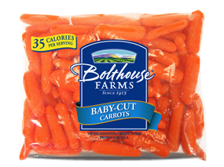
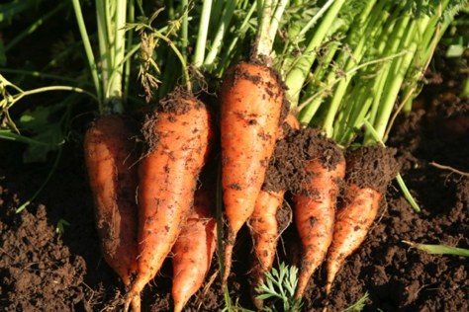
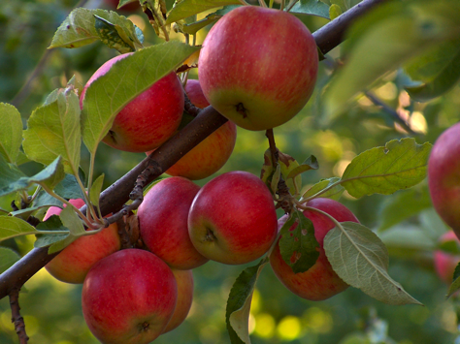
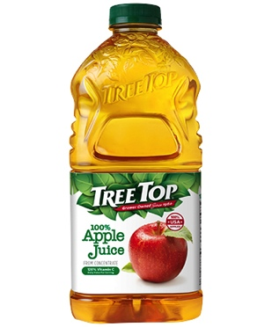
Examples of Food Processing
Washing
Peeling
Cutting
Carrots
Baby Carrots
Juicing
Apples
Apple Juice

Slide 4
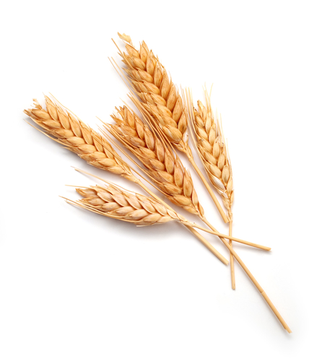
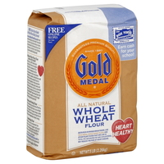
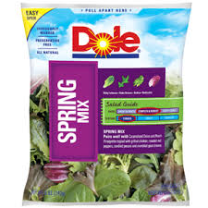
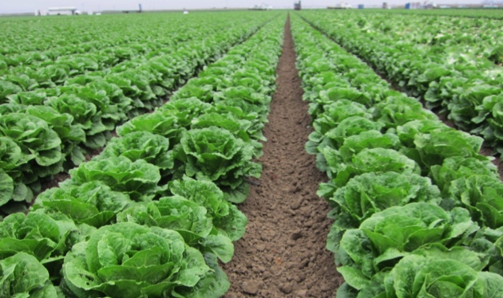
Examples of Food Processing
Grinding
Wheat
Flour
Washing
Lettuce
Bagged Salad

Slide 5
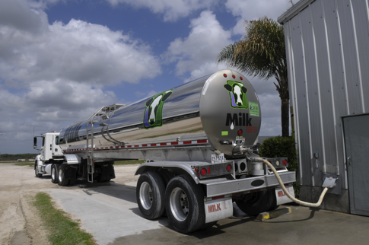
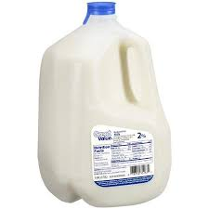
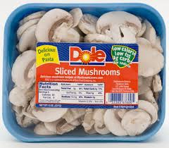
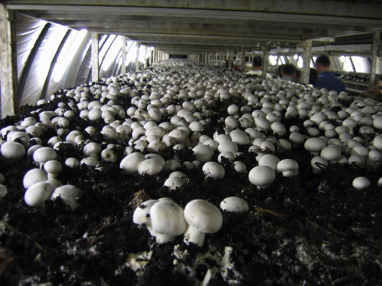
Examples of Food Processing
Pasteurizing
Milk
Milk
Washing
Slicing
Mushrooms
Sliced Mushrooms

Slide 6
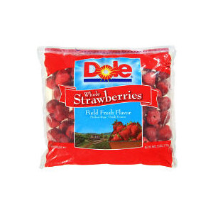
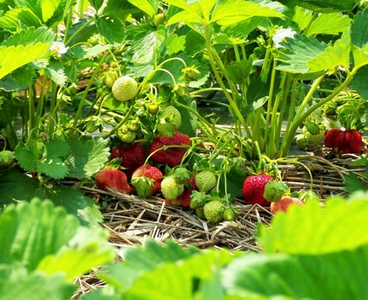
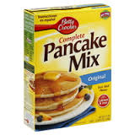
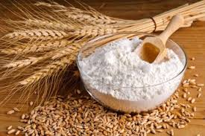
Examples of Food Processing
Freezing
Strawberries
Frozen Strawberries
Mixing ingredients
Flour
Pancake Mix

Slide 7
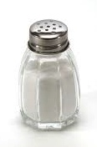
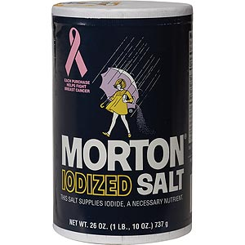
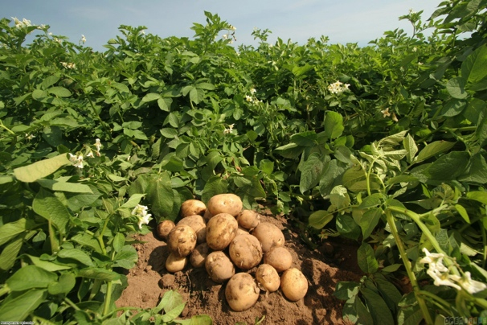
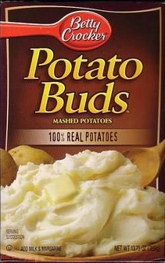
Examples of Food Processing
Fortifying
Salt
Iodized Salt
Cooking
Dehydrating
Potato
Instant Potatoes

Slide 8
Levels of Food Processing
The amount of processing varies from food to food
Minimally Processed
Foods that are washed, peeled, sliced, juiced, frozen, dried, or pasteurized.
Moderately Processed
In addition to being washed, peeled, sliced, etc. these foods may also be cooked, ingredients mixed, and some preservatives added.
Highly Processed
Many ingredients are added to enhance flavor, add vitamins and minerals, and extend shelf life. These foods are mostly or fully prepared for eating.

Slide 9
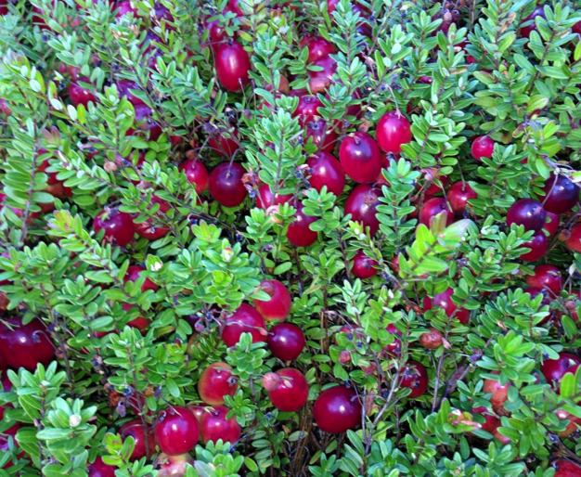
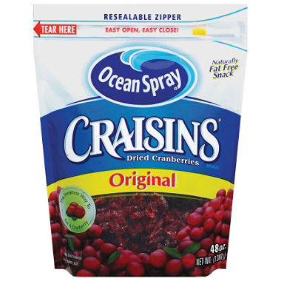
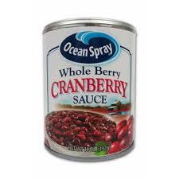
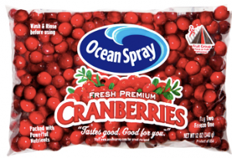
Raw product from the farm
Cranberries
Grow on a bush
Wash and bag whole berries.
Wash berries, dehydrate with added sugar, and package.
Wash berries, cook with added sugar and other ingredients, then seal in can.

Slide 10
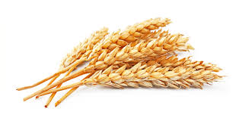
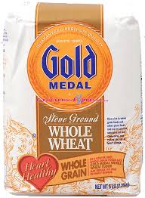
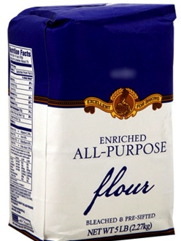
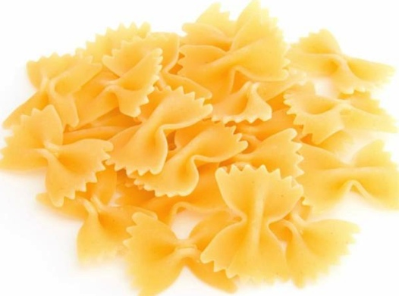
Raw product from the farm
Wheat
Grows in a field, and the seed is harvested
Entire wheat seed is ground into whole wheat flour and packaged.
Wheat seed is separated into its parts. The endosperm is ground into white flour and packaged.
Wheat seed is ground into flour, and additional ingredients are added to make pasta.

Slide 11
How much was it processed?
Minimally Processed
Thumb-down
(low)
Moderately Processed
Thumb-in-the-middle
(medium)
Highly Processed
Thumbs-up
(high)

Slide 12
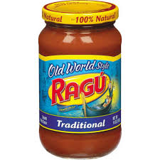
How much was it processed?

Slide 13
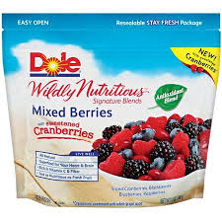
How much was it processed?

Slide 14
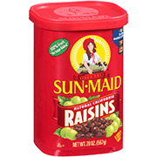
How much was it processed?

Slide 15
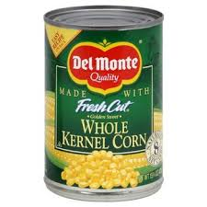
How much was it processed?

Slide 16
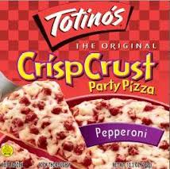
How much was it processed?

Slide 17
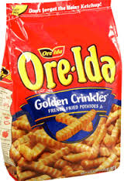
How much was it processed?

Slide 18
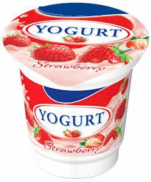
How much was it processed?

Slide 19
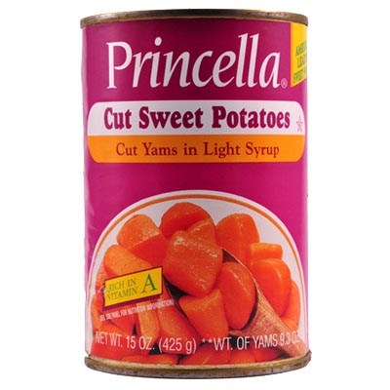
How much was it processed?

Slide 20
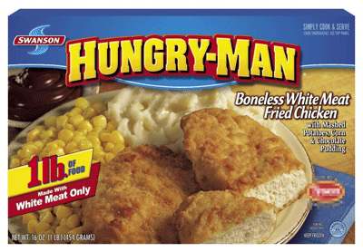
How much was it processed?

Slide 21
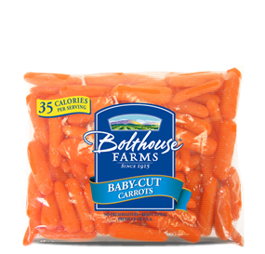
How much was it processed?

Slide 22
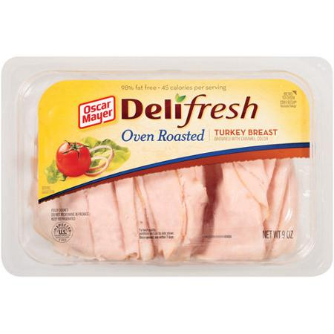
How much was it processed?

Slide 23
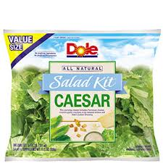
How much was it processed?

Slide 24
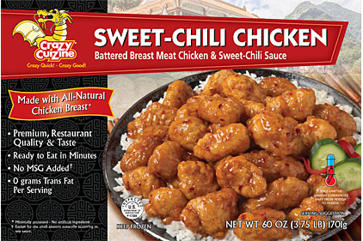
How much was it processed?

Slide 25
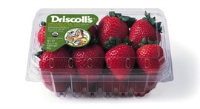
How much was it processed?

Slide 26
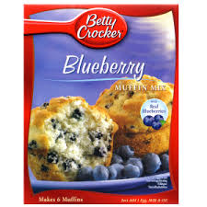
How much was it processed?

Slide 27
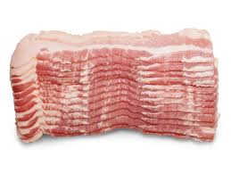
How much was it processed?

