Slide 1
Applying Heredity Concepts

Slide 2
Part 1 Punnett Squares Monohybrid Crosses
 | Parent Alleles
Parent Alleles
Capital letters = dominant trait
Lowercase letters = recessive trait

Slide 3
Homozygous Recessive x Heterozygous

Slide 4
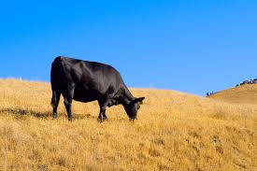
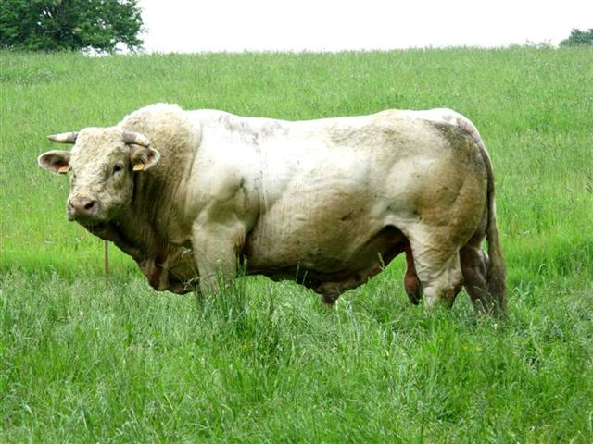
Can you predict the the possible colors of offspring of a homozygous dominant black cow crossed with a homozygous recessive white bull? Work out the possibilities with Punnett Squares.
Mark J Sebastian
Forum concoursvaches.fr
Notes:
Discuss whether it would be possible for all the calves to be white, grey, striped, spotted, etc. What kinds of information should students know to better predict the color of the offspring? Work out the possibilities on the white board using Punnett Squares.

Slide 5
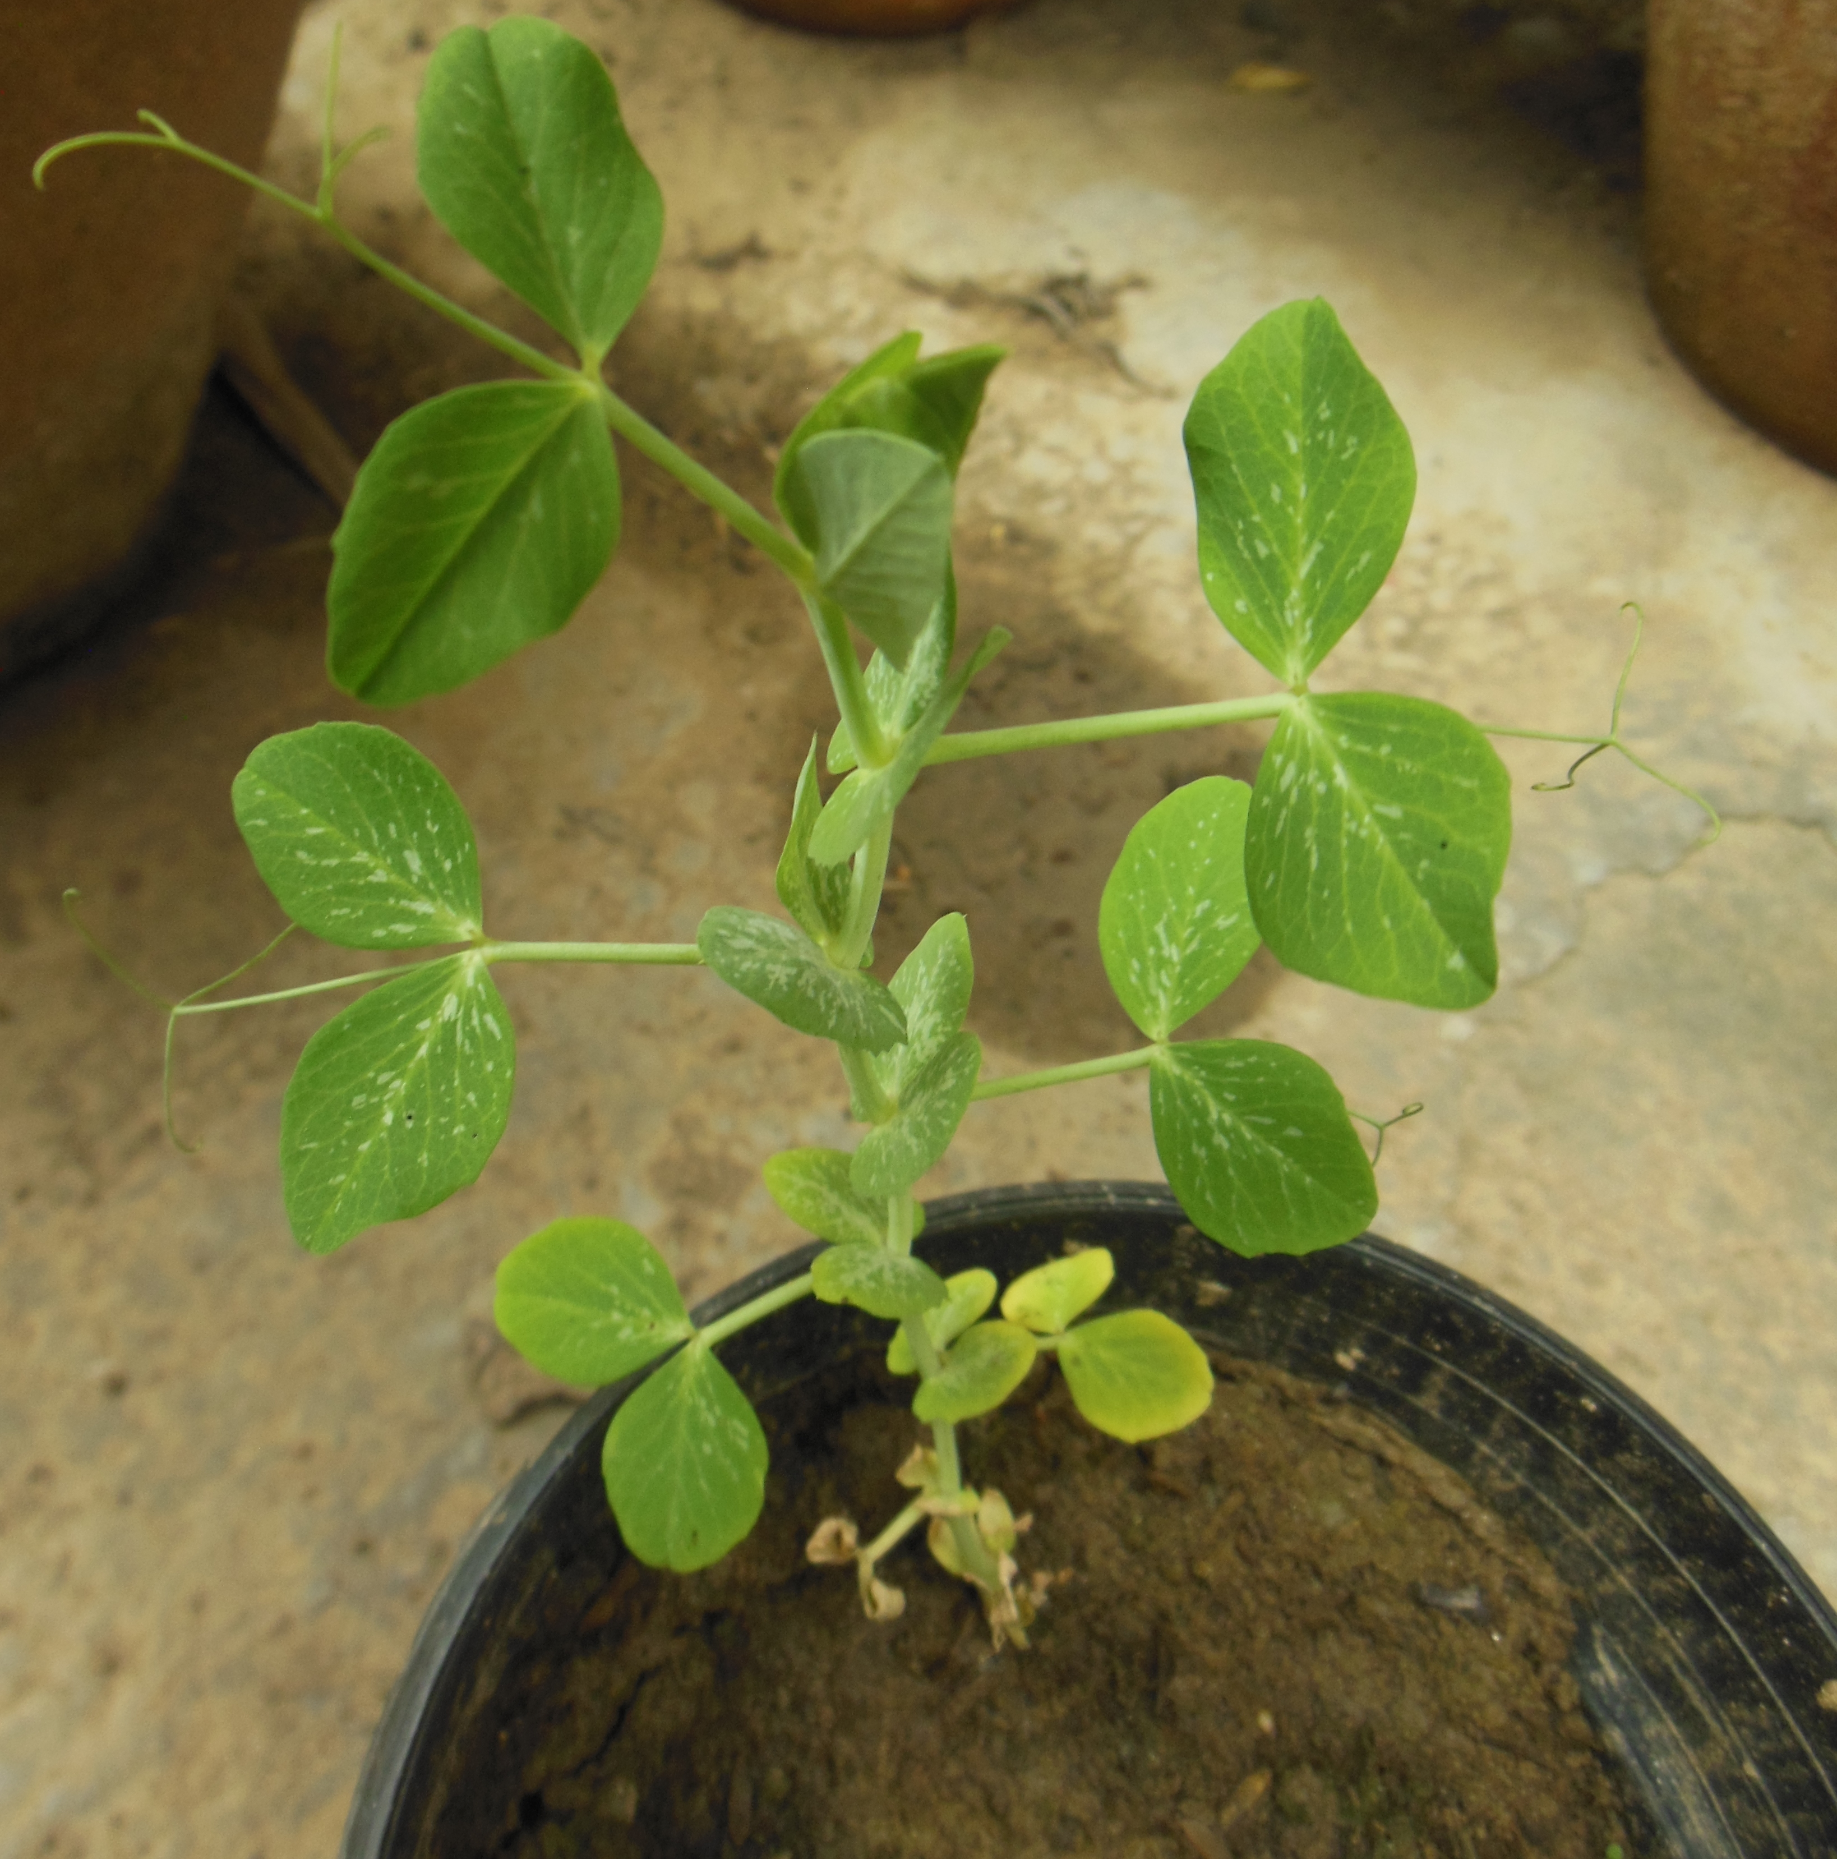
Gregor Mendel and Punnett Squares
T – dominant allele for tall pea plants
t – recessive allele for short pea plants
Predict the offspring genotypes of a homozygous tall (TT) plant crossed with a homozygous short (tt) plant
Predict the phenotypes of offspring of two heterozygous tall (Tt) plants
Predict the offspring genotypes of a heterozygous tall (Tt) plant with a homozygous (tt) short plant
HitroMilanese

Slide 6
In small groups, make up your own Punnett square crosses.
Example – if Googly eyes are dominant to Button eyes, predict the offspring genotypes of one heterozygous Googly eye dad with one Button eye mom.
Consider;
Long/Short Arms
Long/Short Neck
Long/Short Tail
Or any other creative, school appropriate example you create!

Slide 7
Punnet Squares Dihybrid Crosses
Two factor (dihybrid) cross
Example: Height and hair color, flower color and disease resistance.

Slide 8
What happens if you cross a short tailed, white cat (SS bb) with a long tailed, brown cat (ss BB)?

Slide 9
The first generation of offspring will all be short tailed, brown cats because one parent was homozygous dominant for short tails and one parent was homozygous dominant for brown fur.

Slide 10
What would the offspring from two heterozygous short tailed, brown cats be (SsBb) x (SsBb)? According to the Law of Independent Assortment: Pairs of alleles segregate independently of each other when gametes form

Slide 11
Determine the possible outcomes
SsBb x SsBb
SB, Sb, sB, sb
SB, Sb, sB, sb
2. Place your possibilities in a Punnett Square to predict your outcome.
 | SB | Sb | sB | sb
SB
Sb
sB
sb
SB, Sb, sB, sb
SB, Sb, sB, sb

Slide 12
Phenotypes = 9 short brown 3 long brown 3 white short 1 white long Phenotypic ratios = ?

Slide 13
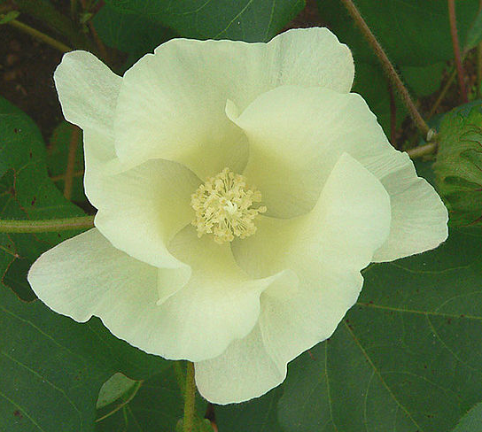
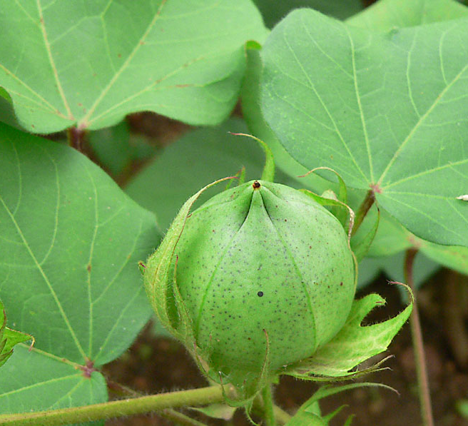
Part 2: You are a cotton farmer!
Azzurro
Chriko
http://www.americasheartland.org/episodes/episode_617/index.htm
Chriko

Slide 14
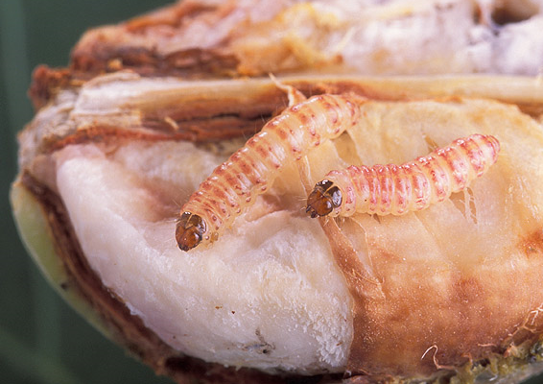
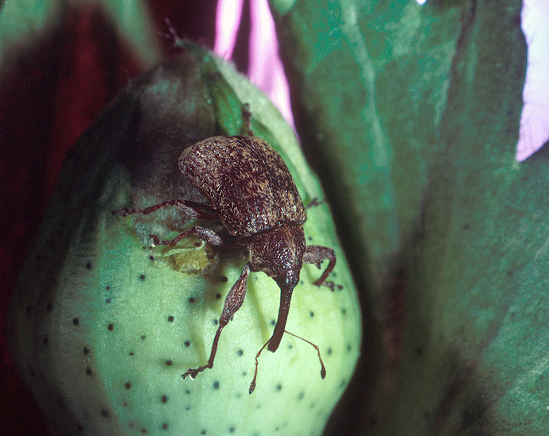
Pink bollworm on damaged cotton boll
USDA ARS
Cotton boll weevil
USDA ARS

Slide 15
Machine Harvest
Kimberly Vardeman

Slide 16
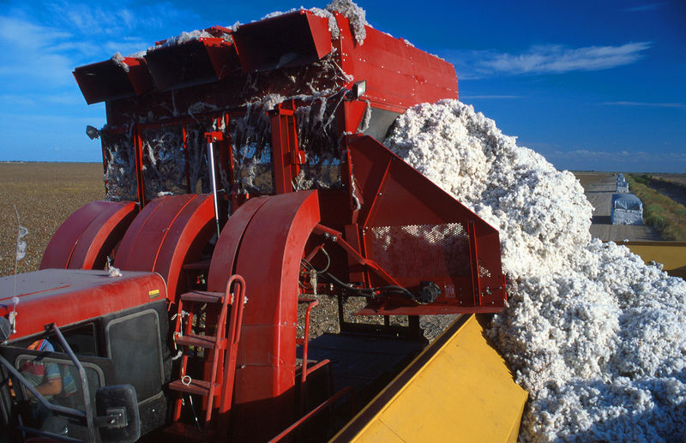
Dumping harvested cotton into module builder
USDA

Slide 17
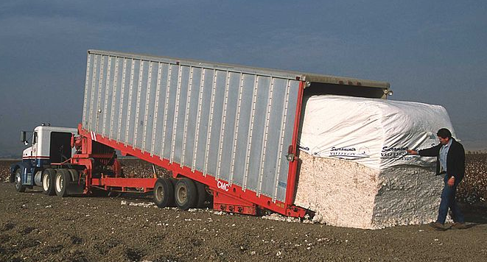
Loading module of cotton for transport to cotton gin.
After seeds and debris are removed at the gin, cotton is packaged into 500 lb. bales.
USDA
Clem Rutter, Rochester, Kent

Slide 18
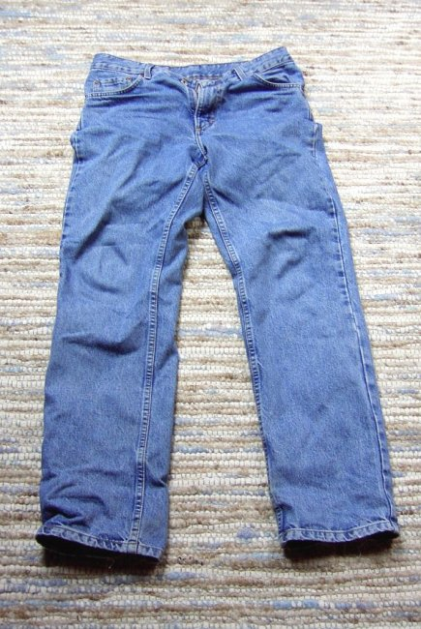
You made an amazing discovery in your cotton field… blue cotton!
The blue color is probably due to a natural gene mutation or possibly from a wild strain of cotton.
You plant seeds from the blue cotton plants and they produce more blue cotton.
You want to know if blue cotton is dominant to white cotton. What should you do?
Notes:
Discuss current research to create a blue colored cotton
Give directions for activity
Condense page 25 and 26 into one document

Slide 19
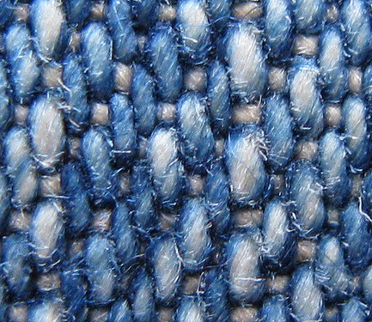
The Blue Genes Challenge
Mark Michaelis
After crossing a blue cotton plant with a white cotton plant, you find that it produces blue and white streaked cotton.
This is a case of ___________dominance.

Slide 20
How could you market this cotton?
Run another test cross by crossing two heterozygous plants. B (-) x B (-)
What percentage of the offspring produce white cotton?
What percentage of the offspring produce blue cotton?
What percentage of the offspring produce blue and white striped cotton?

Slide 21
You name your company Blue Genes Incorporated and begin marketing your product.
What parent genotypes should you cross to harvest the most blue and white streaked cotton?

Slide 22
Part 3 Blue Genes Incorporated has become wildly successful and your farm is trying to meet the demand for blue and white streaked cotton. However, you begin to notice a problem in the cotton fields…

Slide 23
The blue and white streaked cotton seems to be especially vulnerable to pests. Your plants are being devoured by insects

Slide 24
You have heard of something called Bt cotton and want to know if this could help you with your insect problem.
What are the facts on Bt cotton?
Developed to counteract the increasing resistance of insects to pesticides and cost of using them

Slide 25
Genetically modified by inserting genes from soil bacterium Bacillus thuringiensis into cotton plant genes.
Soil bacterium genes produce protein in plant’s tissues that protect plant from pests.
Bt is only toxic to insects that have receptor sites where the Bt proteins can bind in their guts. Humans, dogs, rats, fish, frogs, guinea pigs, salamanders, birds, honey bees, lady beetles, and most beneficial insects are not affected by Bt.

Slide 26
U.S. Environmental Protection Agency (EPA) tested Bt cotton for toxicity and allergens to humans and many organisms
EPA approved Bt for commercial use in 1995
The advantage of Bt cotton is that fewer plants are lost to insect damage and less pesticides need to be used.
As of of 2013, approximately 75% of the cotton planted in the United States is Bt cotton.
What do you think, could this be a solution for your pest problem in your blue and white streaked cotton crop? Explain.

