Slide 1
Origami Flower Instructions

Slide 2
1. Arrange the origami paper on a flat surface, color side down, with one corner pointing at you.

Slide 3
2. Fold the paper in half by bringing the bottom corner up to meet the top corner.

Slide 4
3. Fold the bottom right and left corners to the top corner. Crease and unfold.

Slide 5
4. Fold both the bottom left and right lines to meet the crease you made in step 3.

Slide 6
5. Flip the paper over. Fold the triangular tabs forward. Crease and unfold.

Slide 7
6. Flip the paper over. Use a glue stick to glue the right and left bottom triangles together. This completes one section.

Slide 8
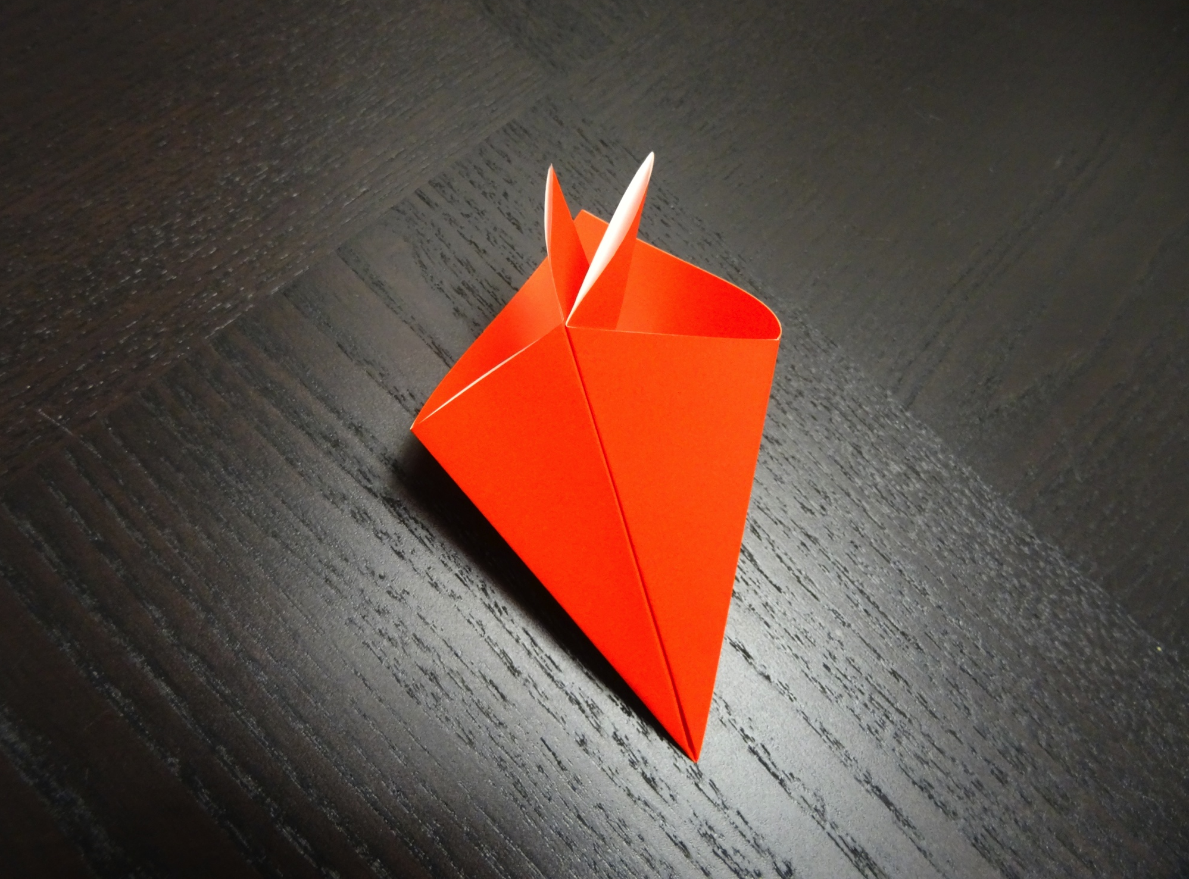
7. Repeat steps 1-6 to make a total of four or five sections.
1
2
3
4
5
6

Slide 9
8. Join the sections together by gluing the flat triangles together.

