Slide 1
2025 Colorado Literacy Project
Cattle, Corn, and Courage
The Story of Dr. John Matsushima

Slide 2
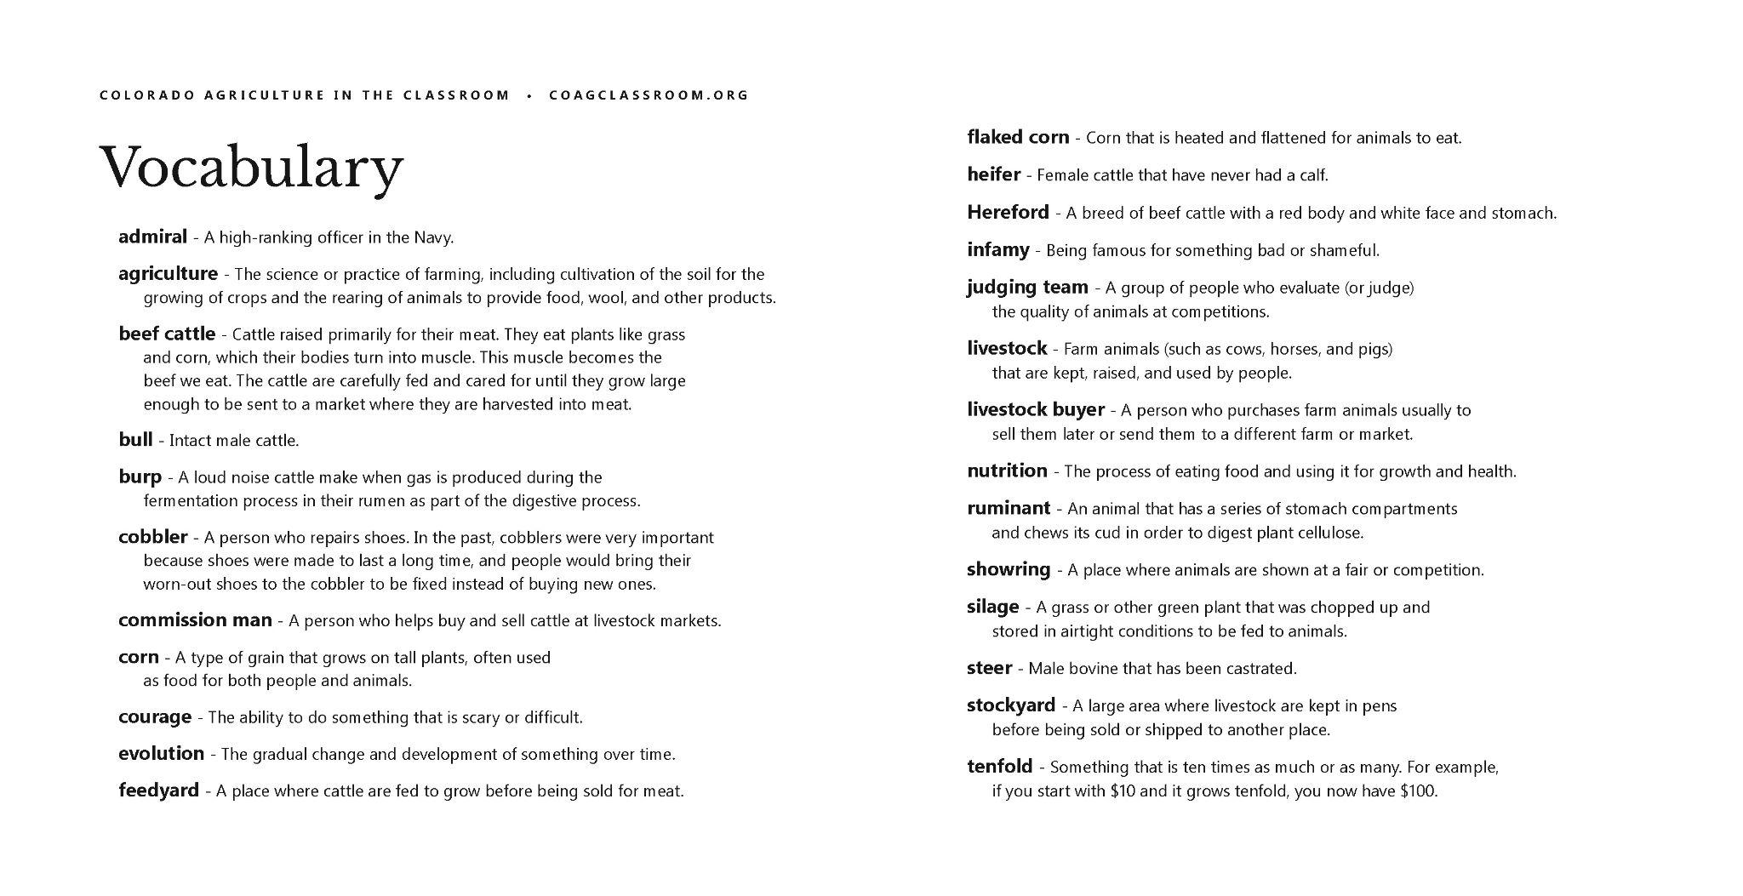

Slide 3
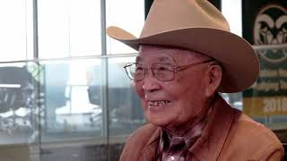
Notes:
**NOTE: The Q&A video with Dr. Matsushima and the Documentary video are coming soon!

Slide 7
Additional Sponsors
Honor Roll Level
Class Leader Level
Rachel Gabel
Mesa County Cattlemen’s Association
Mesa County CattleWomen
Alpine Bank
Grassroots Advocate Level
Many businesses, local organizations, and individuals

Slide 11
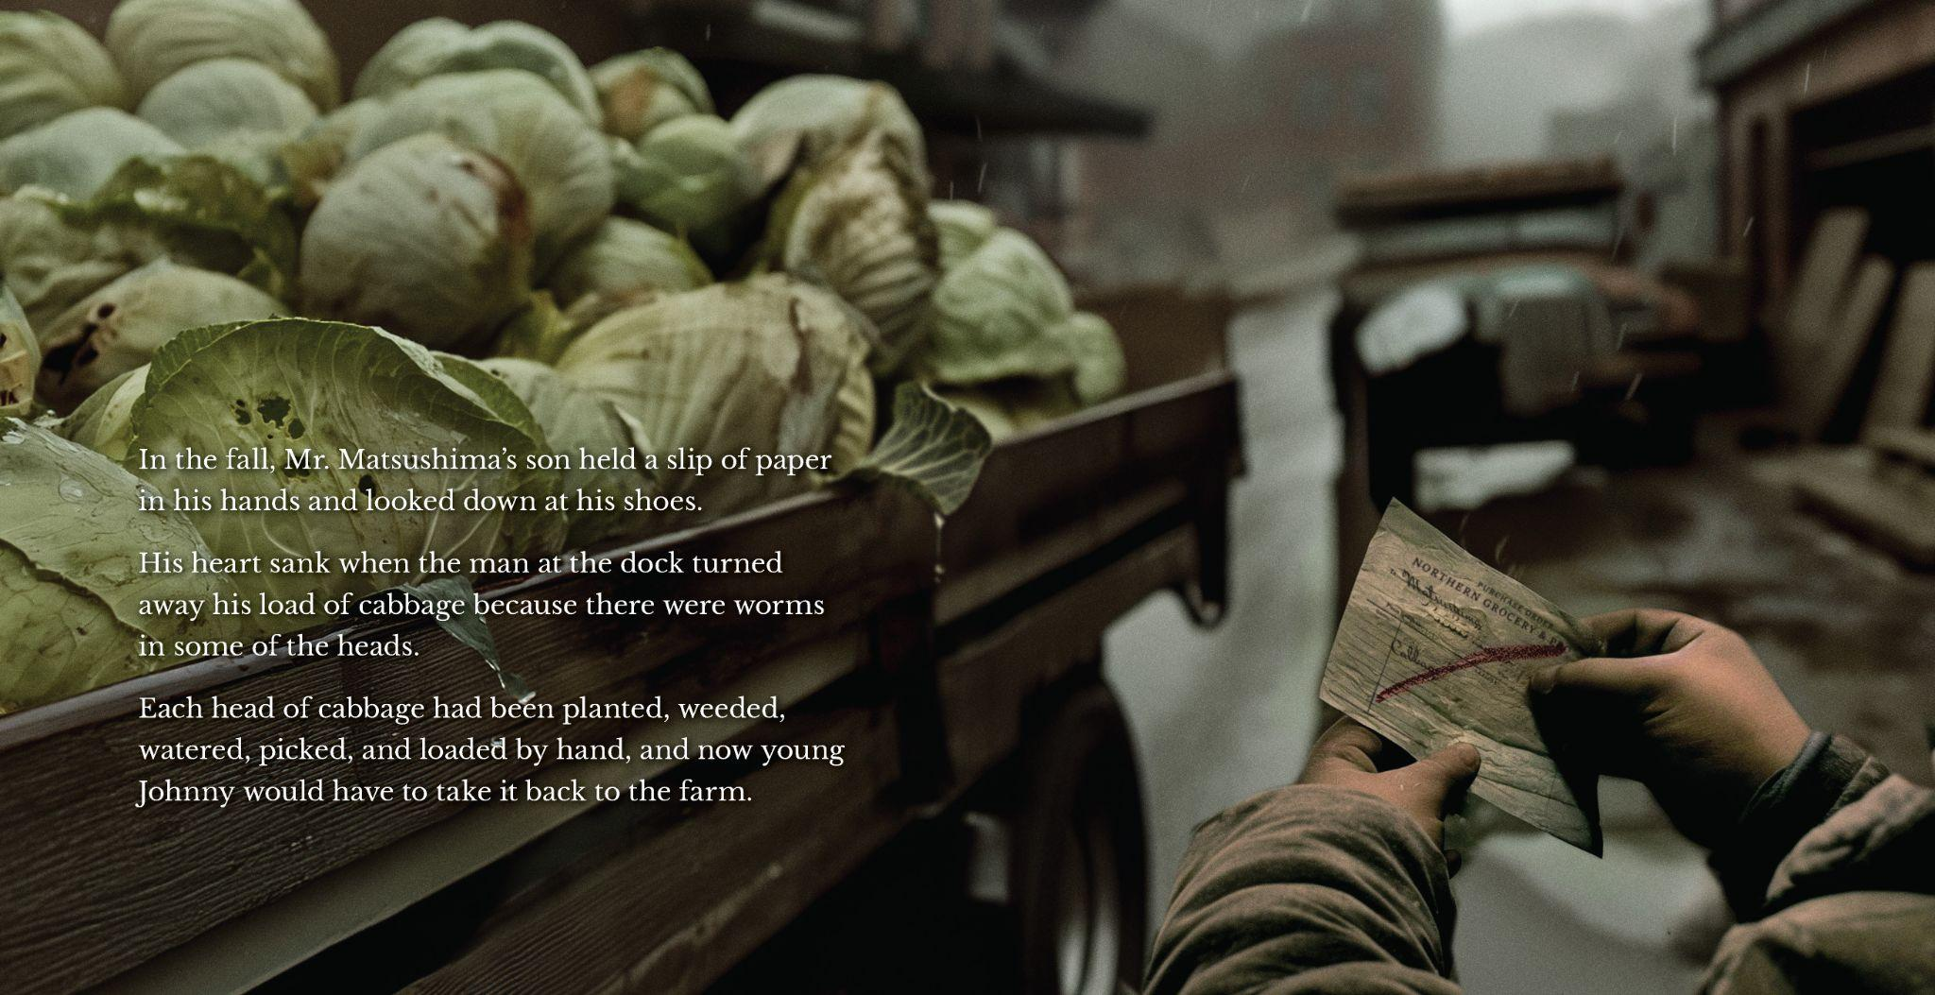

Slide 12
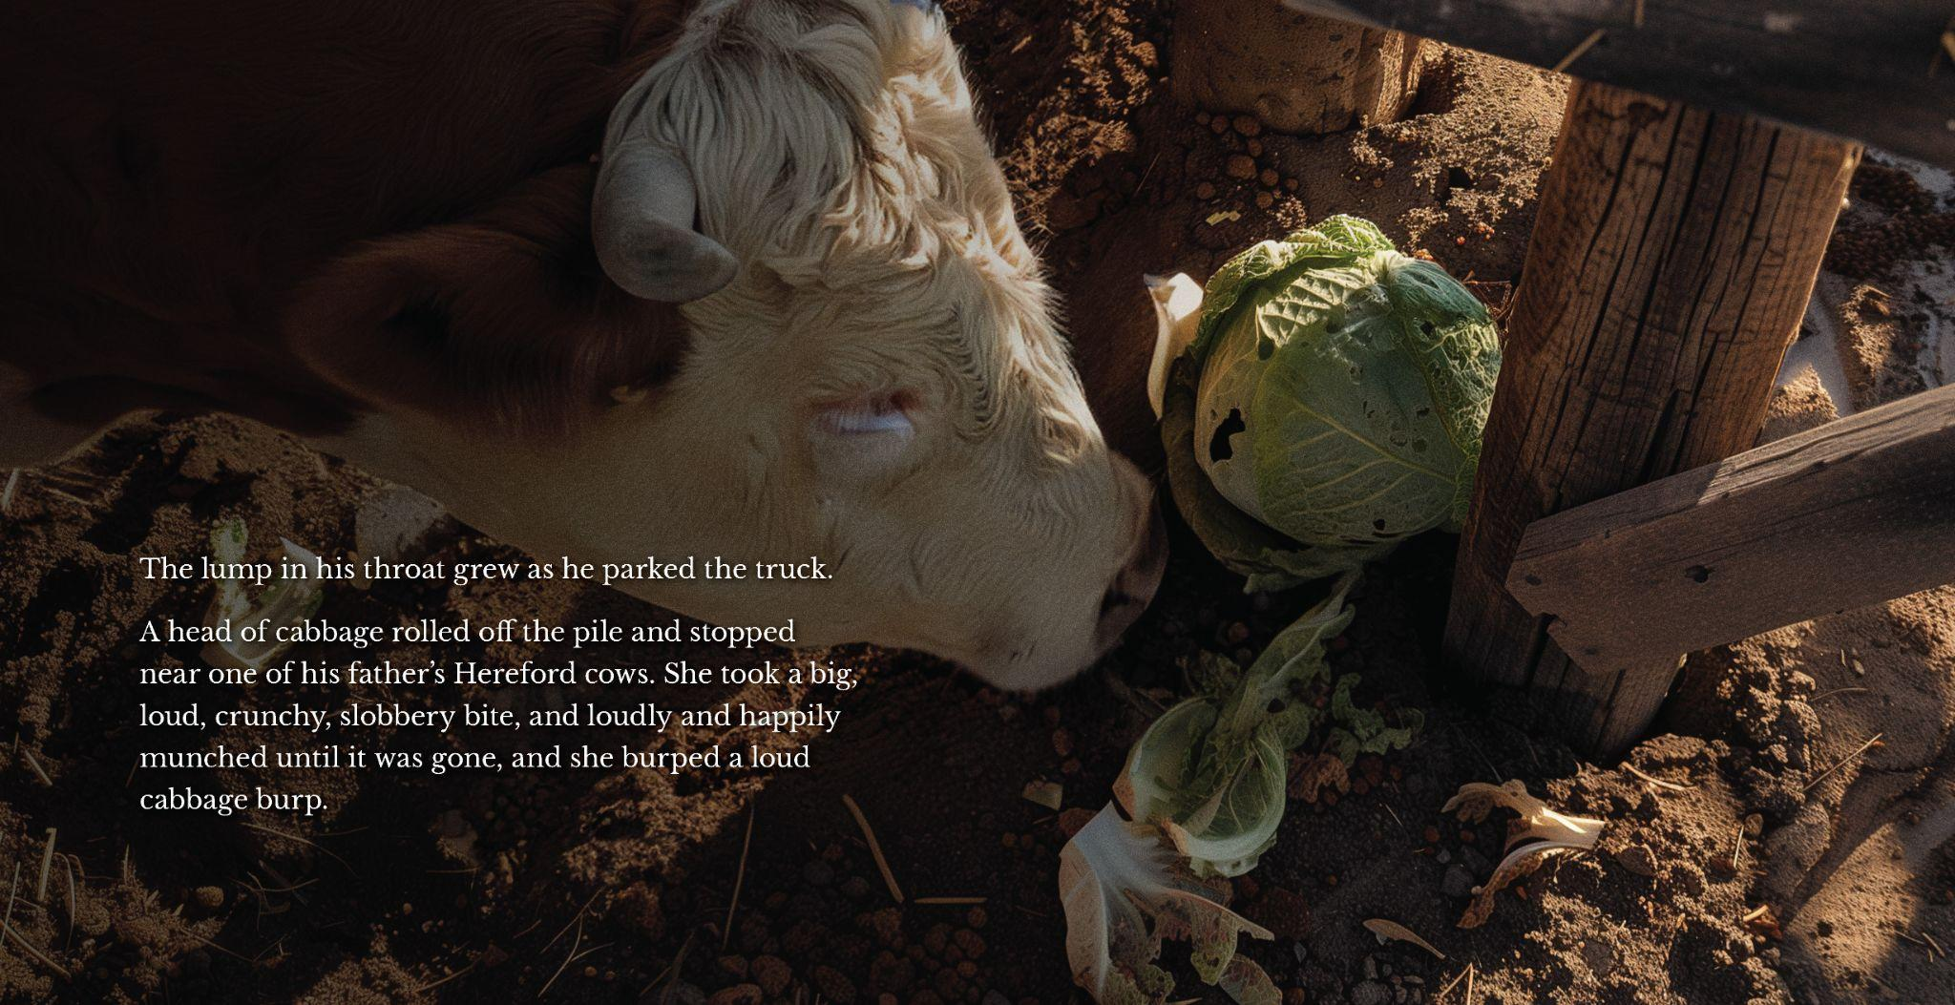

Slide 13
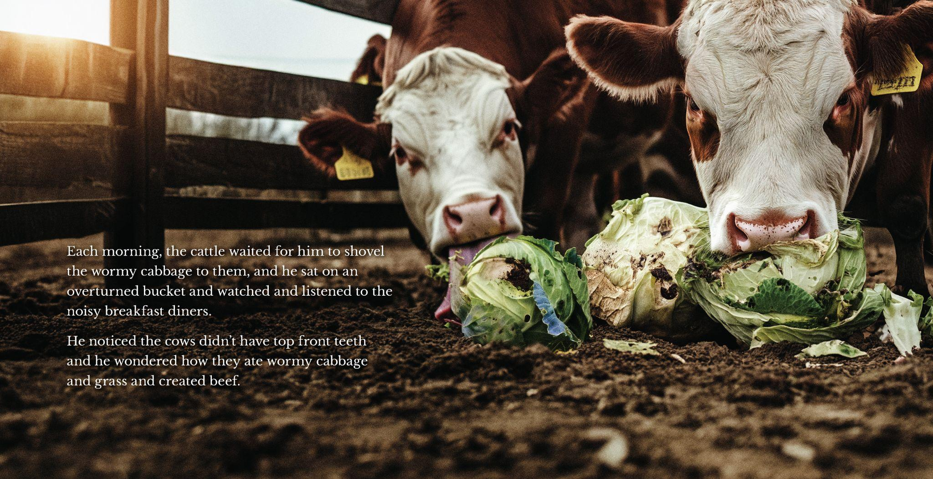

Slide 14
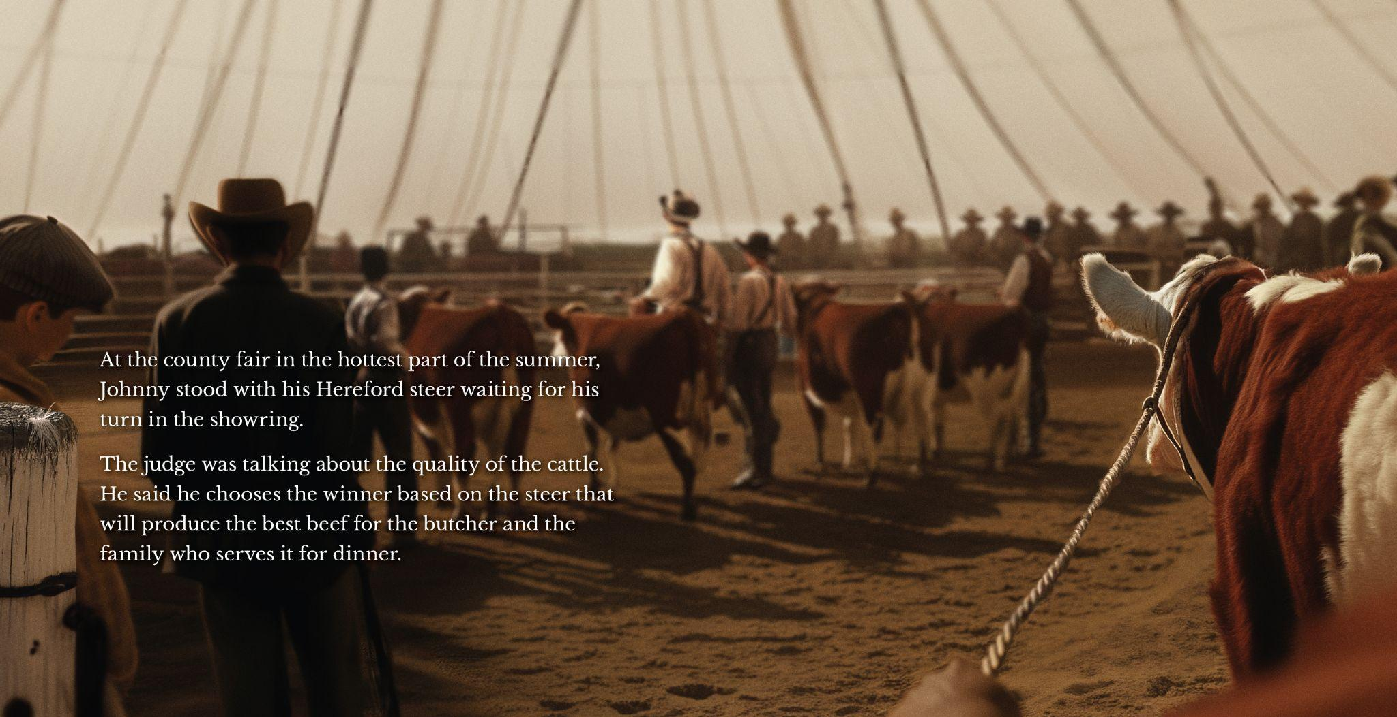

Slide 20
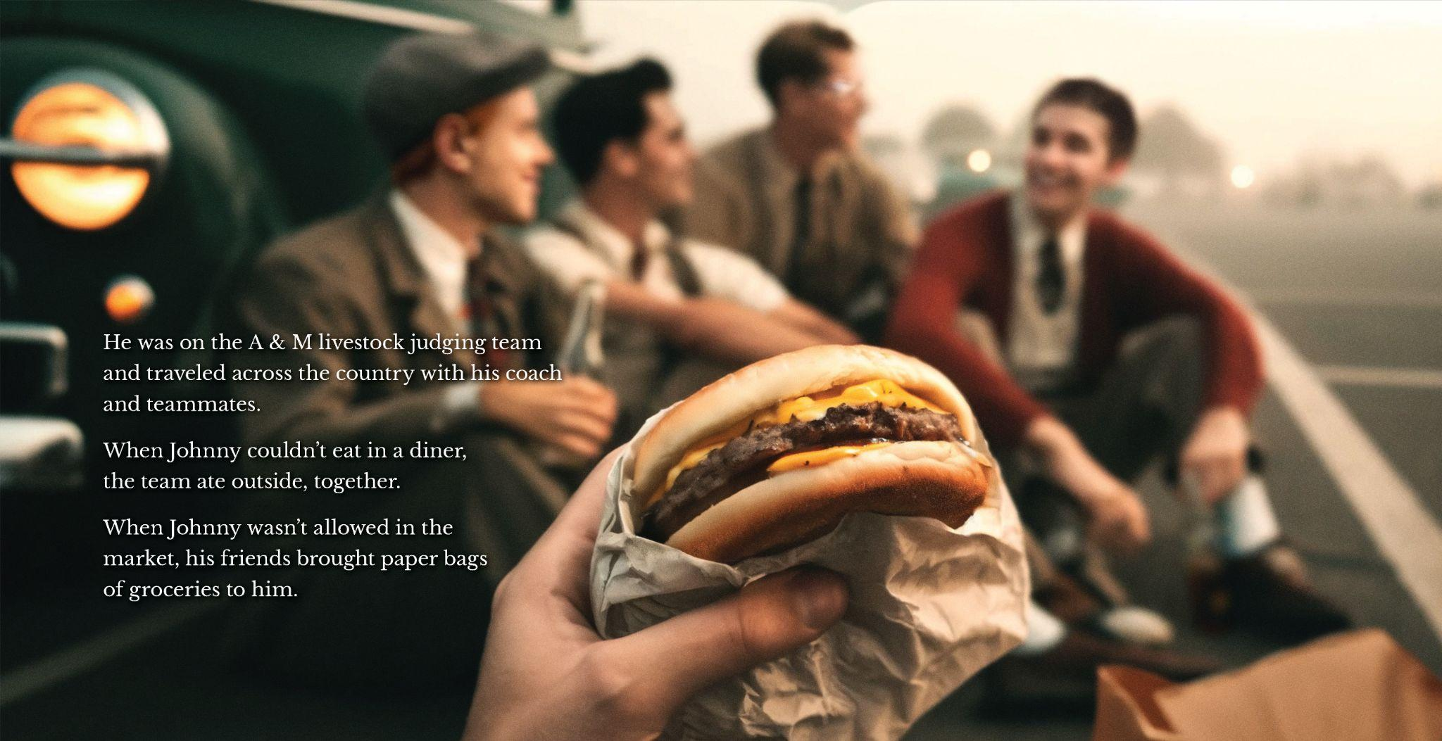

Slide 21
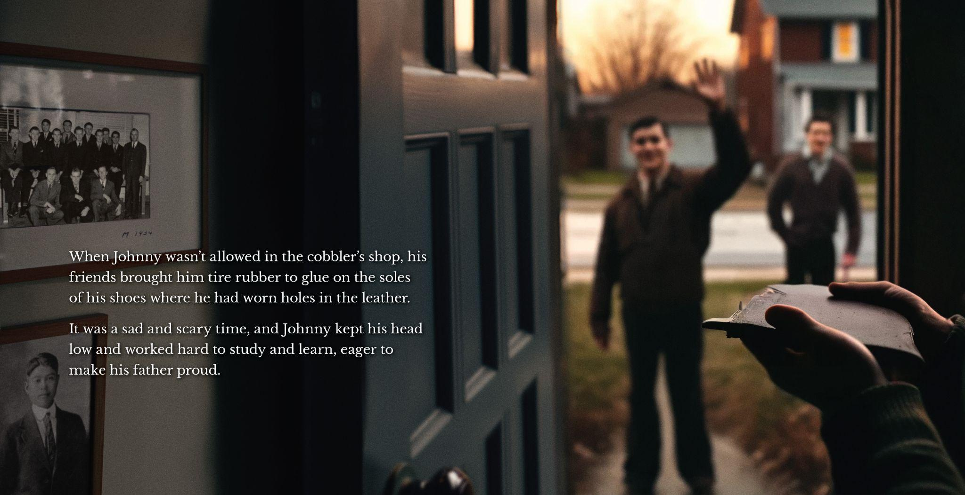

Slide 22
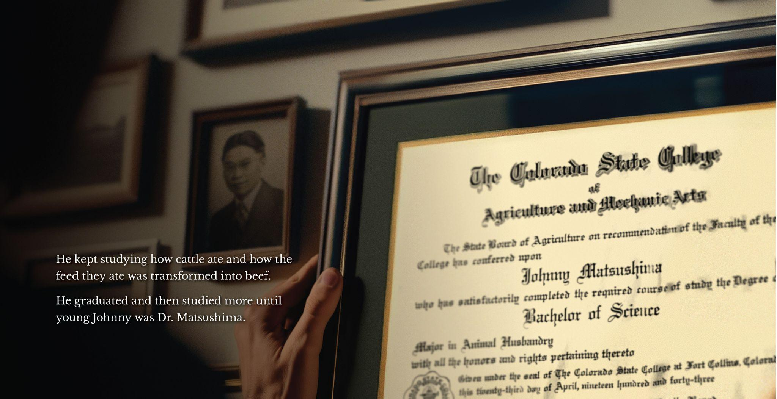

Slide 26
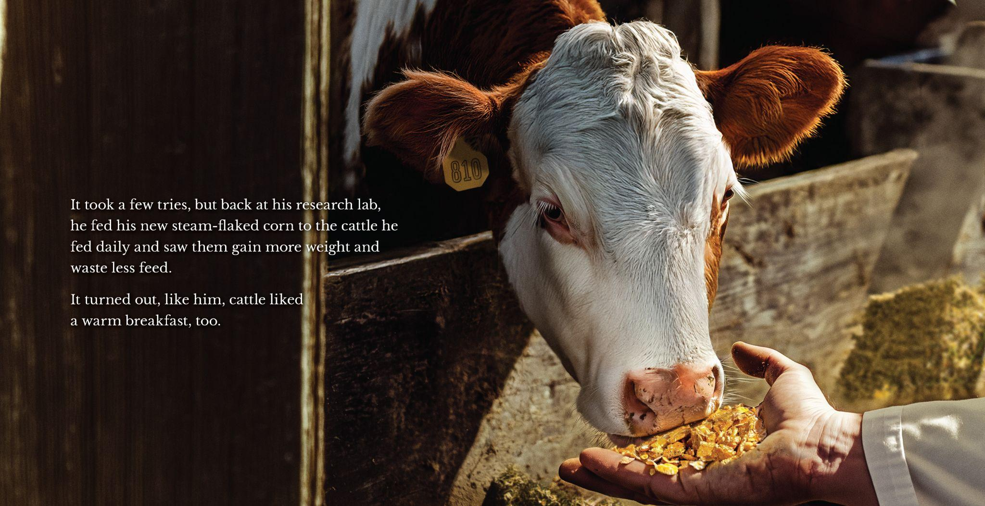

Slide 27
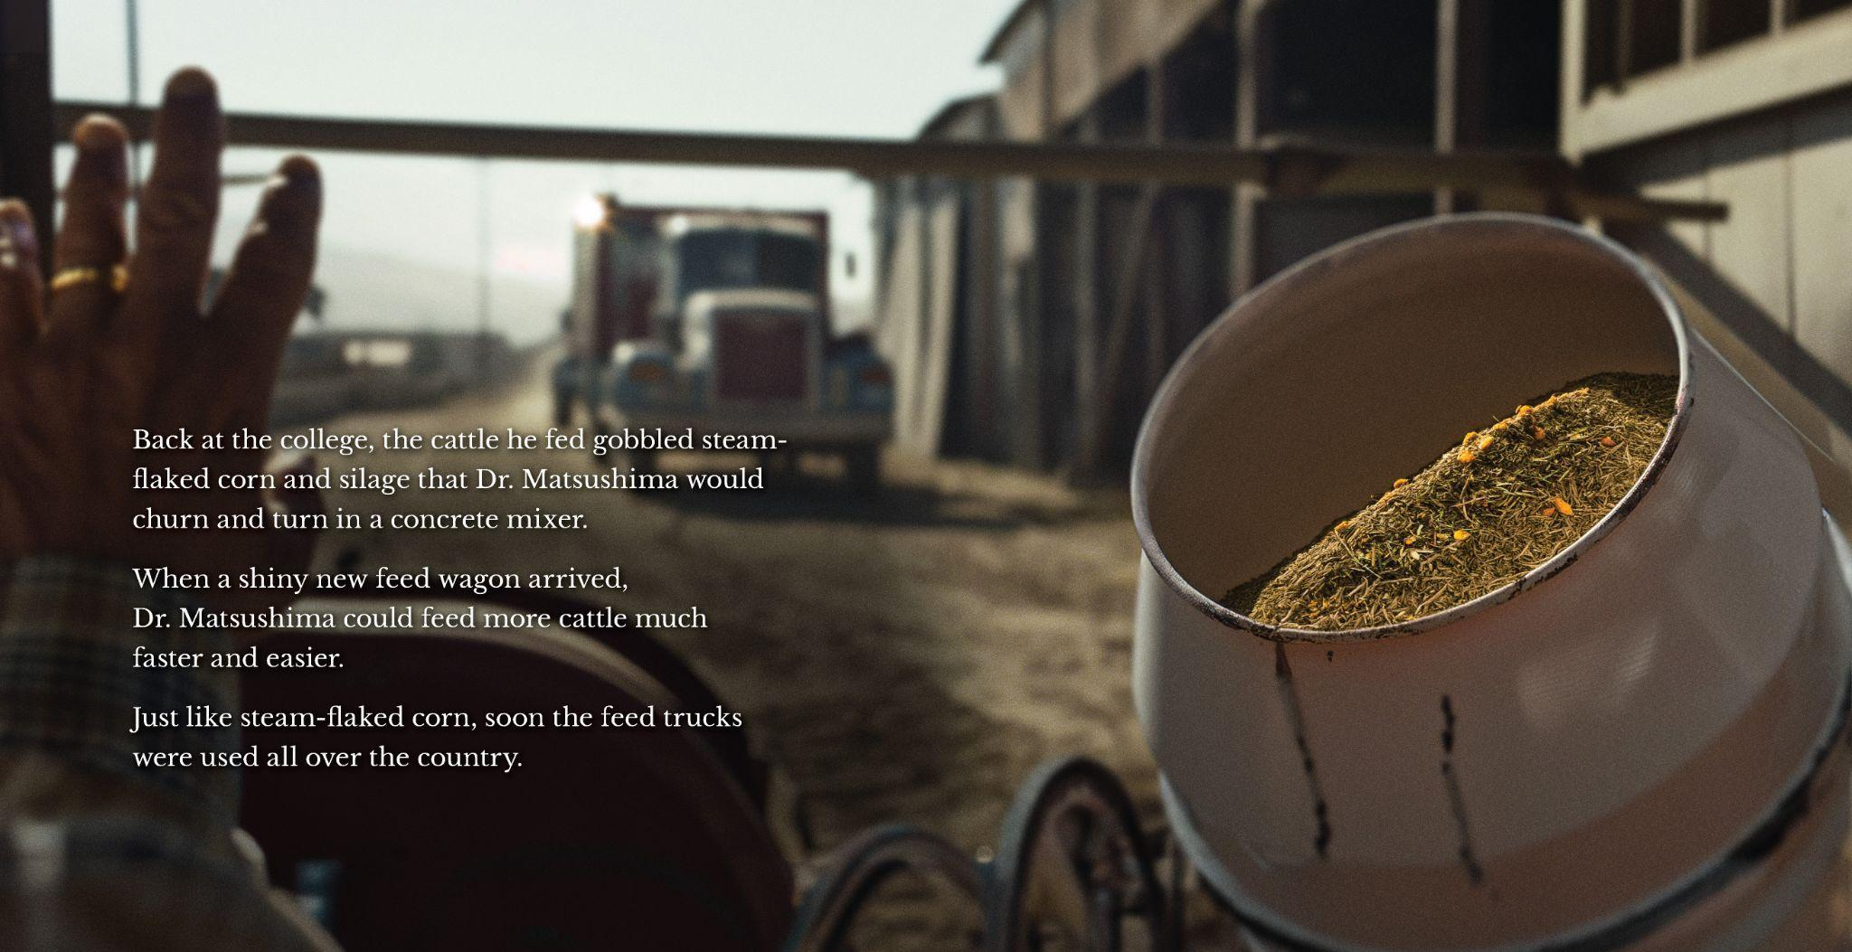

Slide 30
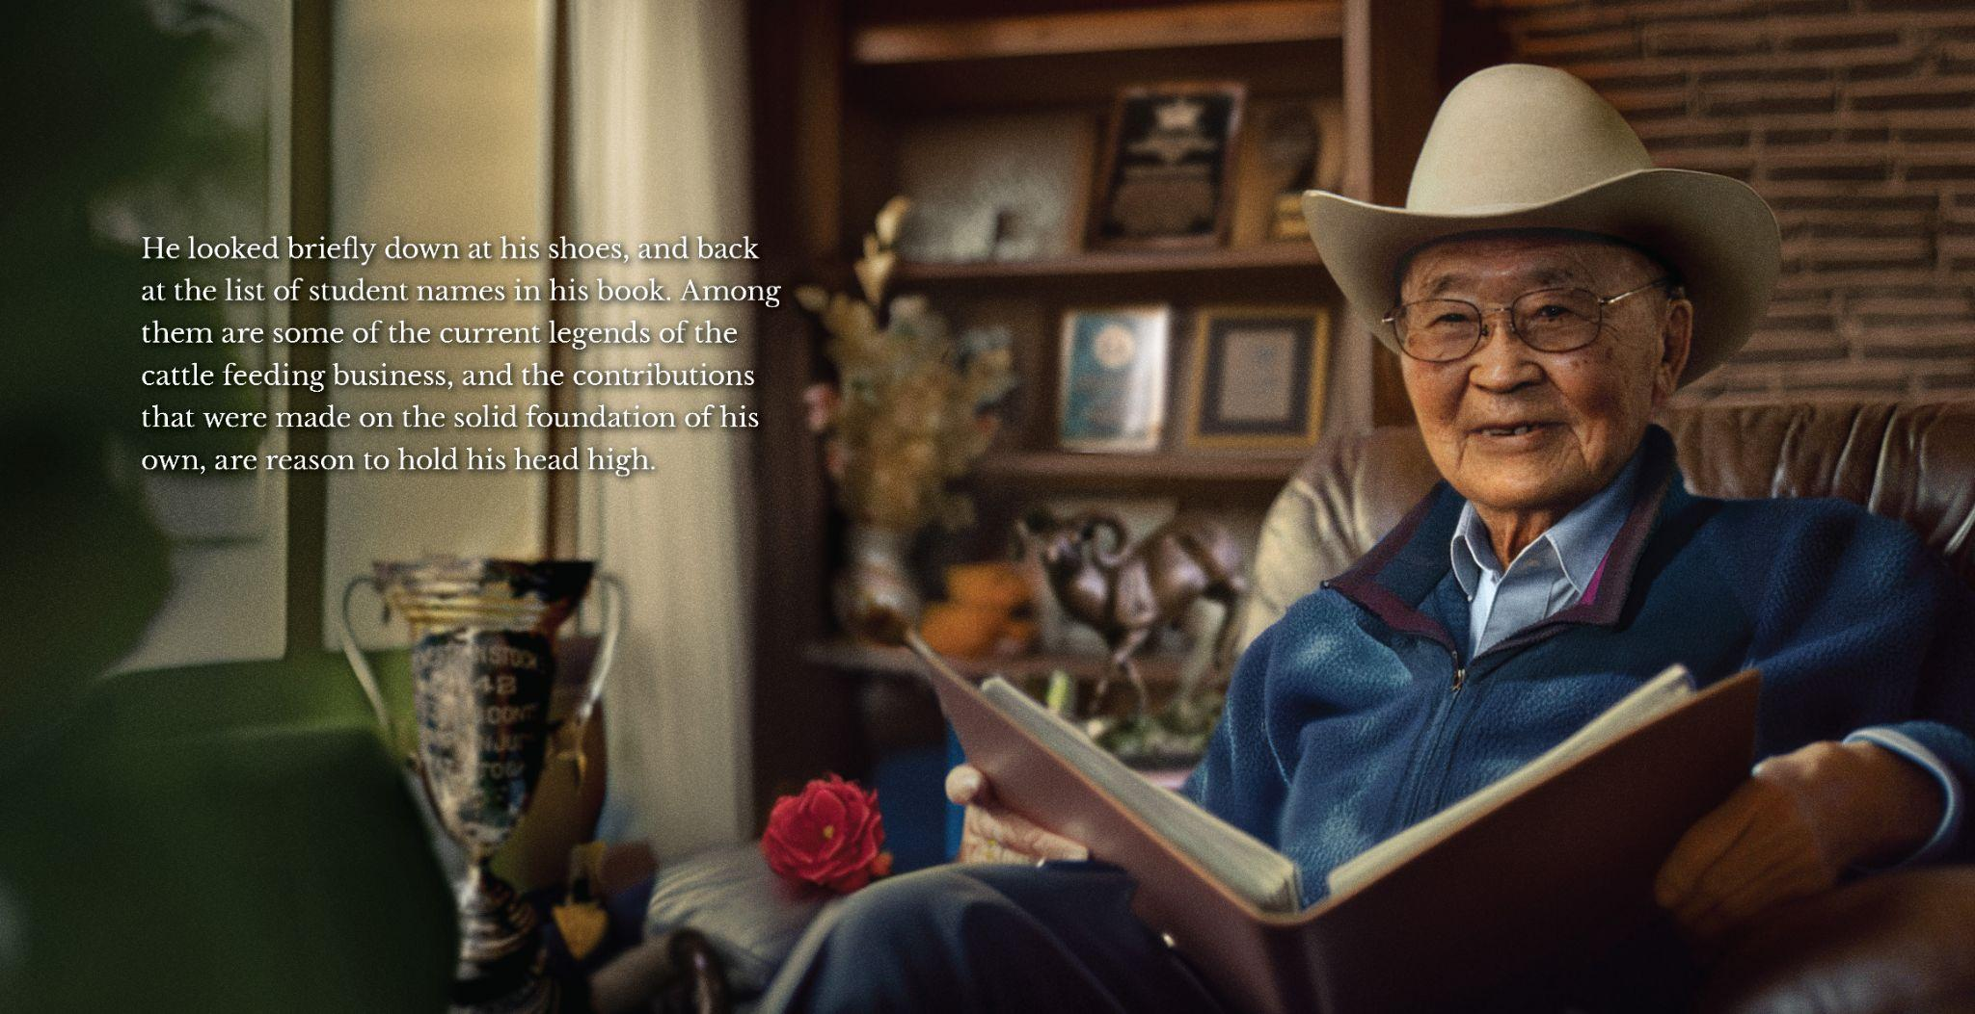

Slide 34
