Slide 1
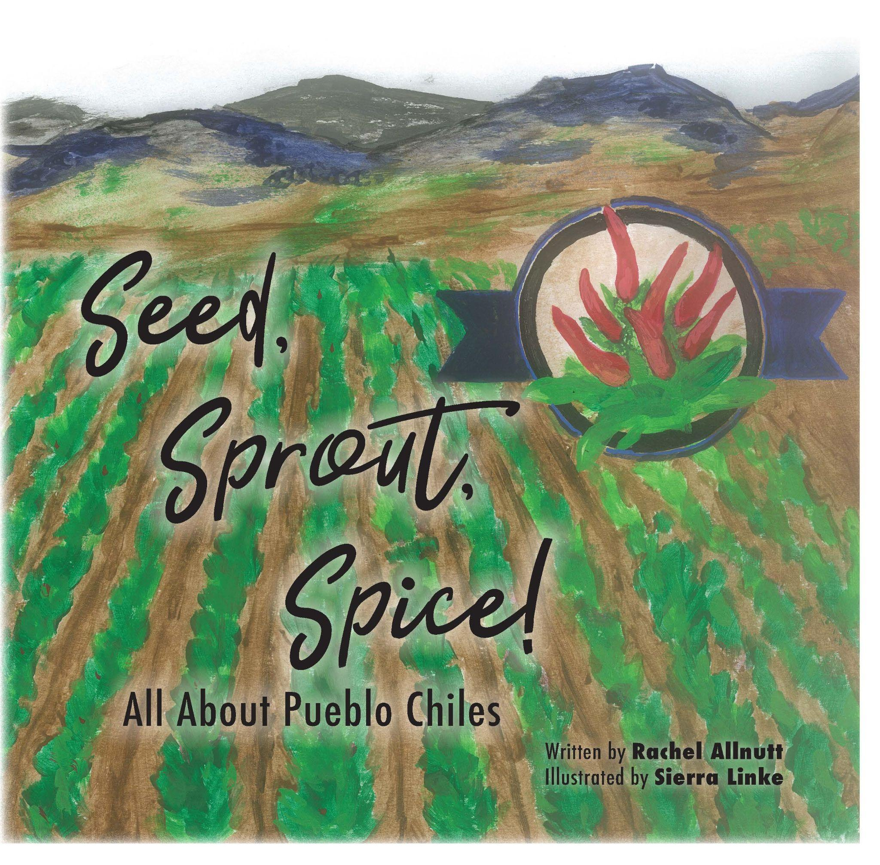
2024 Colorado Literacy Project
Seed, Sprout, Spice!
All About Pueblo Chiles

Slide 2
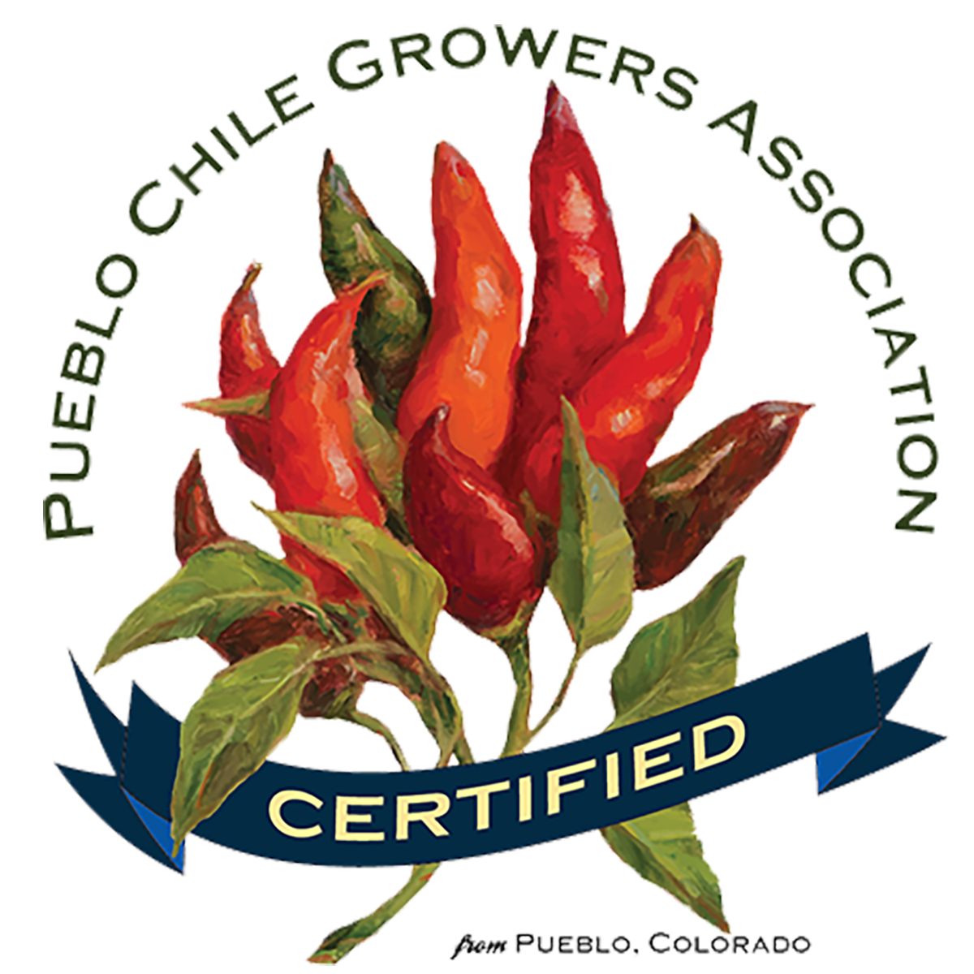
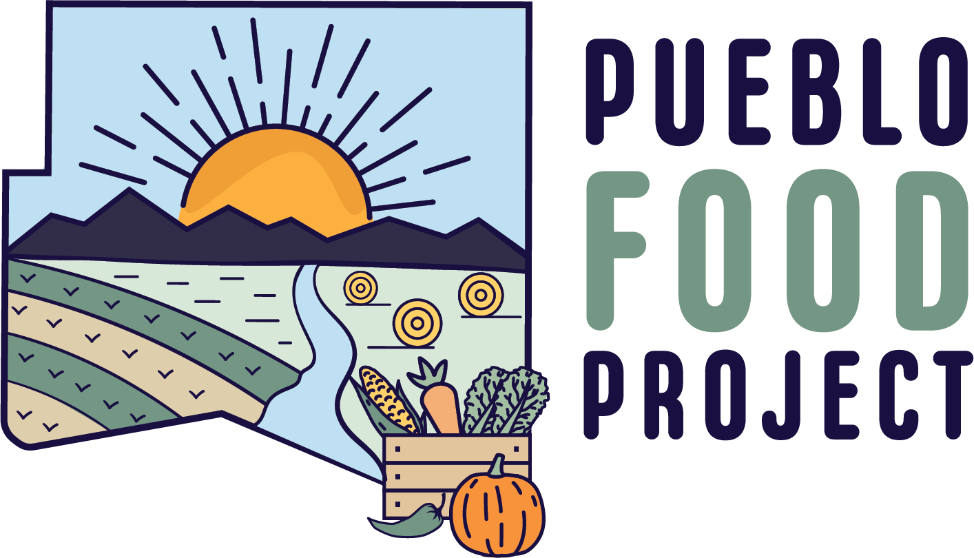
This program was made possible by:
Specialty Crop Block Grant Program
And various individual sponsors and donors.

Slide 3
Pre-Test Student Question #1
Are chile peppers grown in Colorado?
Thumbs UP for YES!
Thumbs Down for NO!
Thumbs Sideways for NOT SURE!
Teachers and/or Volunteers, please record student responses.

Slide 4
Pre-Test Student Question #2
Have you ever heard of Pueblo Chiles?
Thumbs UP for YES!
Thumbs Down for NO!
Thumbs Sideways for NOT SURE!
Teachers and/or Volunteers, please record student responses.

Slide 5
Pre-Test Student Question #3
Have you ever eaten Pueblo chiles?
Thumbs UP for YES!
Thumbs Down for NO!
Thumbs Sideways for NOT SURE!
Teachers and/or Volunteers, please record student responses.

Slide 6
Pre-Test Student Question #4
Are Pueblo Chiles an important crop for Colorado Agriculture?
Thumbs UP for YES!
Thumbs Down for NO!
Thumbs Sideways for NOT SURE!
Teachers and/or Volunteers, please record student responses.

Slide 7
Vocabulary Words
Arkansas River - the Arkansas River is 1,469 miles long and the sixth-longest river in the United States. It’s a major tributary of the Mississippi River, and its source is located near Leadville, in Colorado’s Rocky Mountains. It travels through four states before it reaches its mouth and namesake in Arkansas.
breeding quality - desirable genetic traits cultivated through selective reproduction in animals or plants to enhance specific characteristics in successive generations.
capsaicin - a colorless, crystalline, bitter compound; the substance measured to determine spiciness.
cultivating - the planting, tending, improving, or harvesting of crops or plants. The preparation of ground to promote their growth.

Slide 8
Vocabulary Words
discing - to work the land with a disc harrow; a piece of equipment with sharp circular implements.
fertilizing - supplementing the existing soil with needed nutrients.
irrigation - the artificial application of water to the soil through various systems that may consist of pumps, valves, pipes, and sprinklers. These networks distribute water to the entire field uniformly. Irrigation is usually used in areas where rainfall is irregular, during dry times, or when drought is expected.
roasting - cooking whole chiles in a large rotating roaster.
Scoville Heat Scale - a scale of spicy taste for a chile pepper when assigned a numerical measure in Scoville heat units. Determined by a chemical measure of capsaicin levels.

Slide 9
Vocabulary Words
siphon tube - a tube bent into a curve, for use in drawing water from one area to another, such as from a ditch into rows.
soil health (health of the soil) - the continued capacity of soil to function as a vital living ecosystem that sustains plants, animals, and humans. Healthy soil provides clean air and water, bountiful crops and forests, productive grazing lands, diverse wildlife, and beautiful landscapes.
sowed - to scatter seeds over land for growth.
sprinkler - large mechanical method of applying water in a controlled manner that is similar to rainfall. Sprinklers can be used for residential, industrial, and agricultural usage.
transplant - to move from one place and plant it in another.
yield - to give forth or produce by a natural process or in return for cultivation.

Slide 11
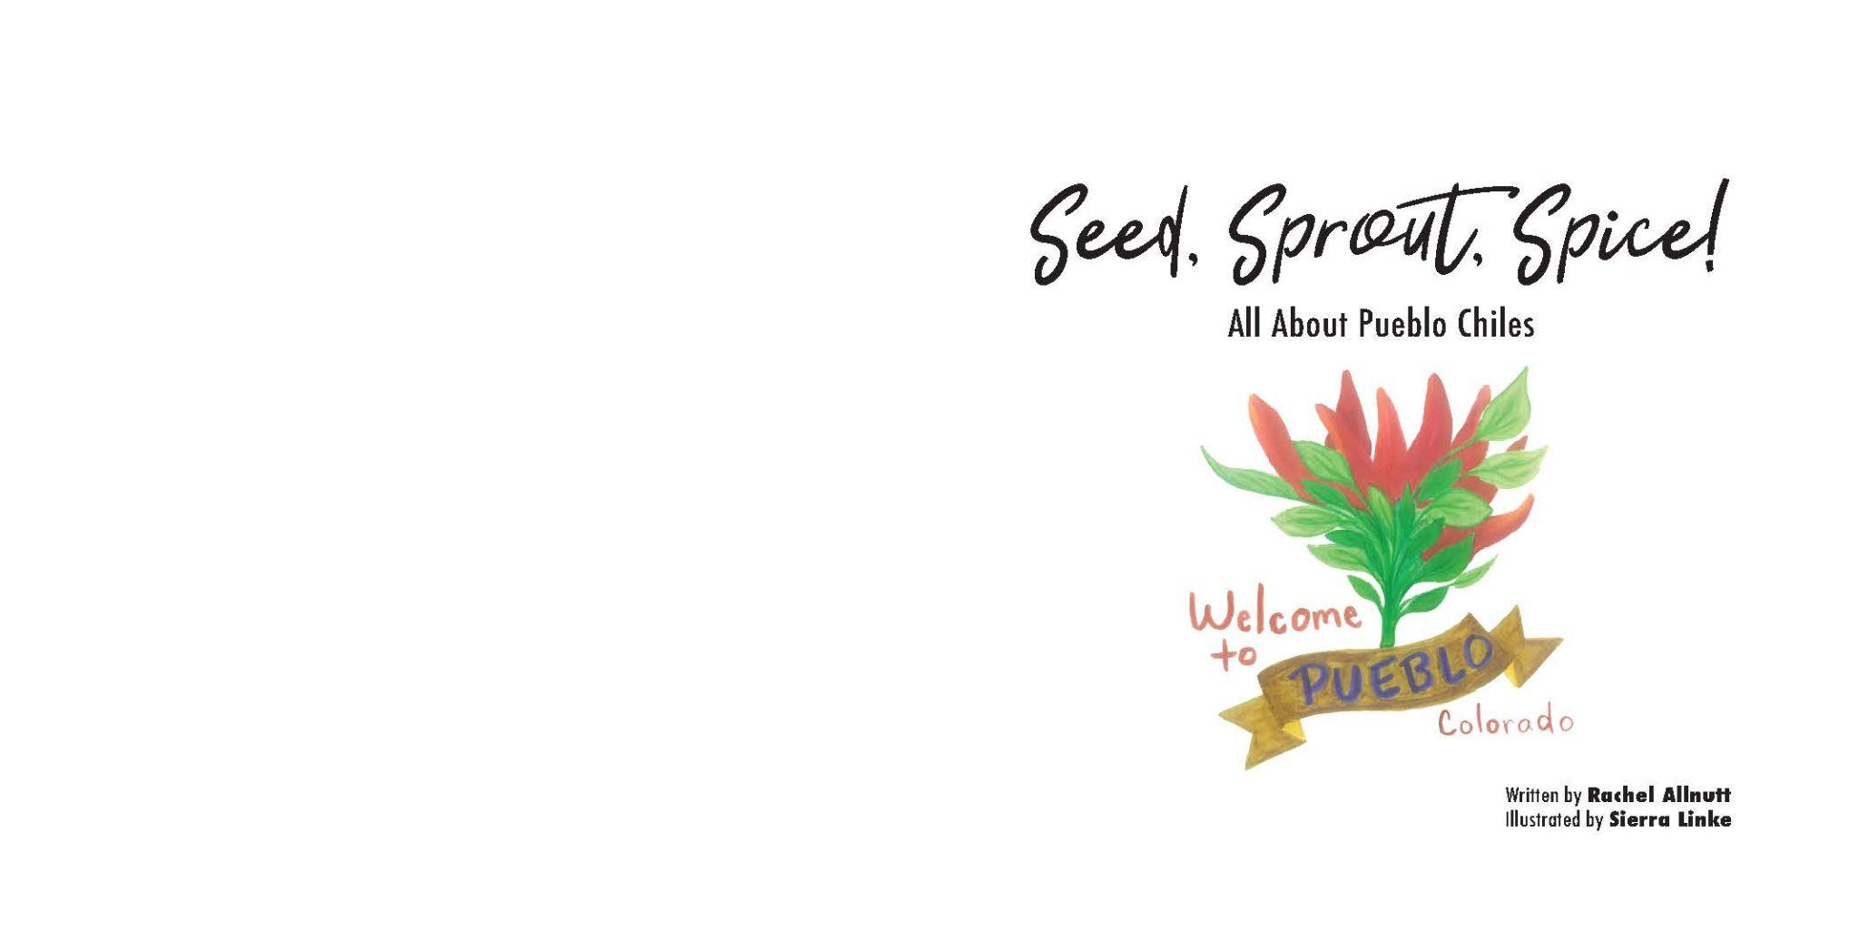

Slide 12
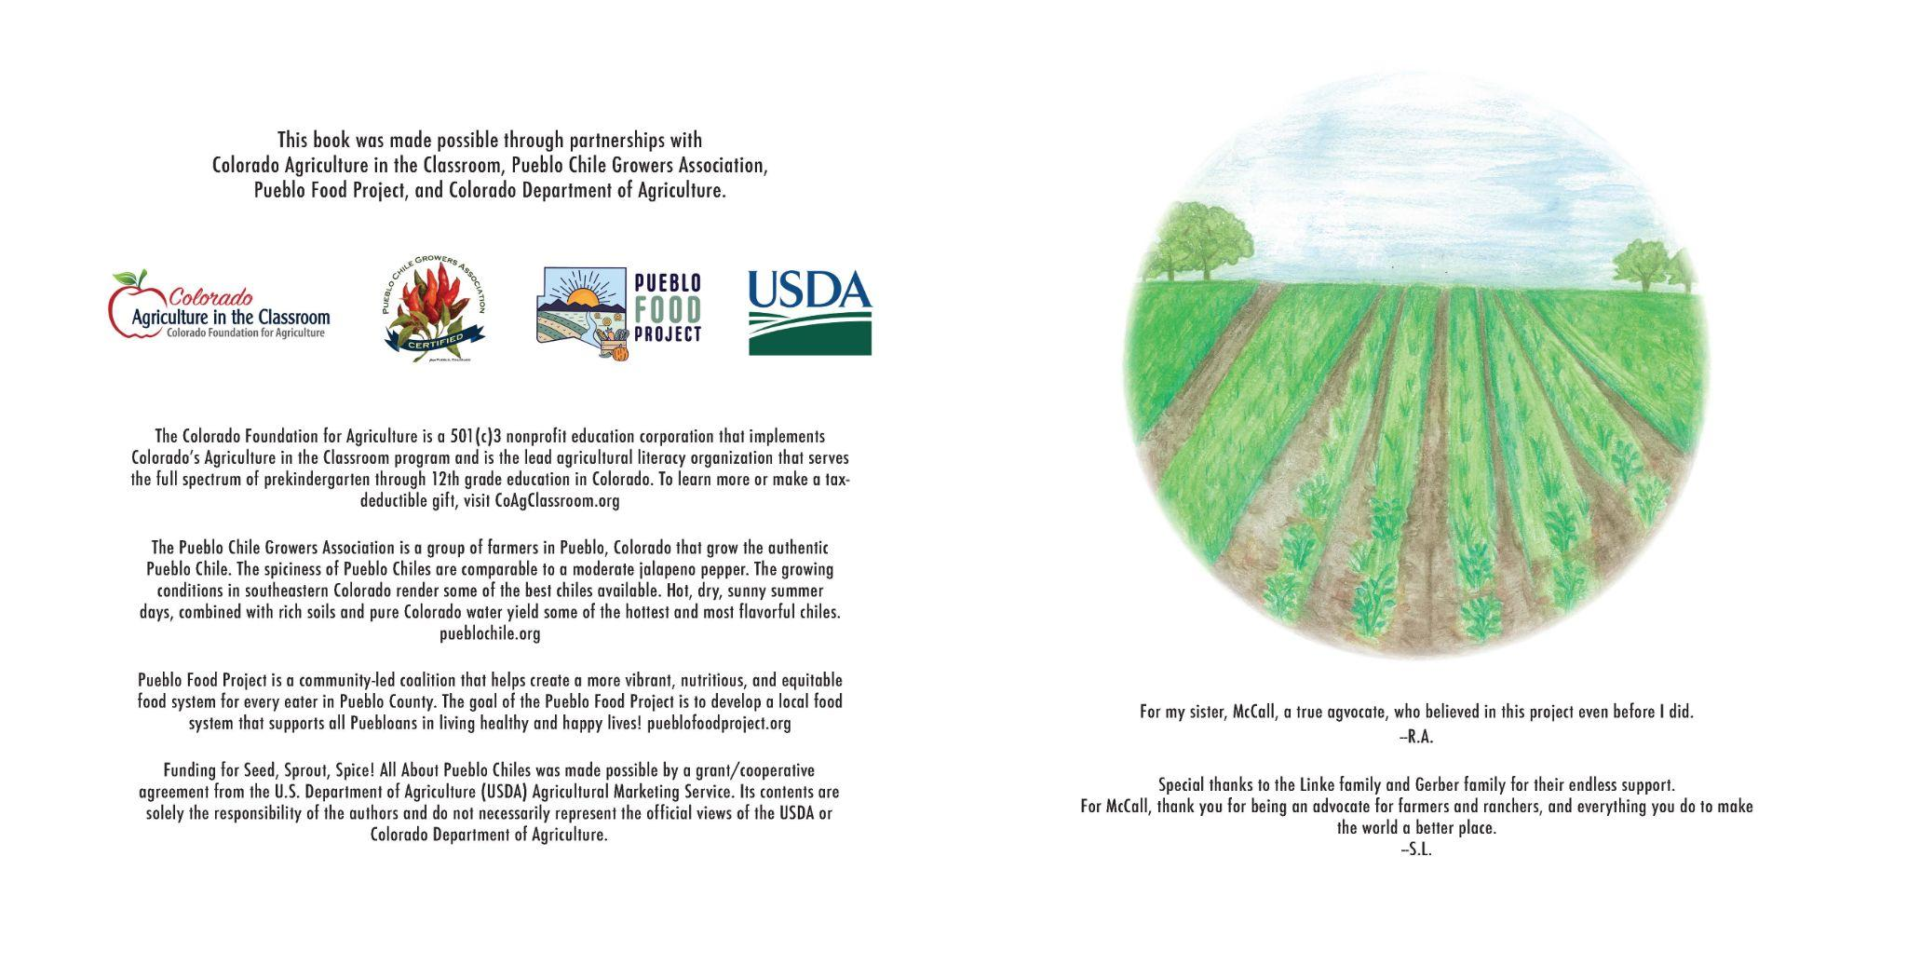

Slide 13
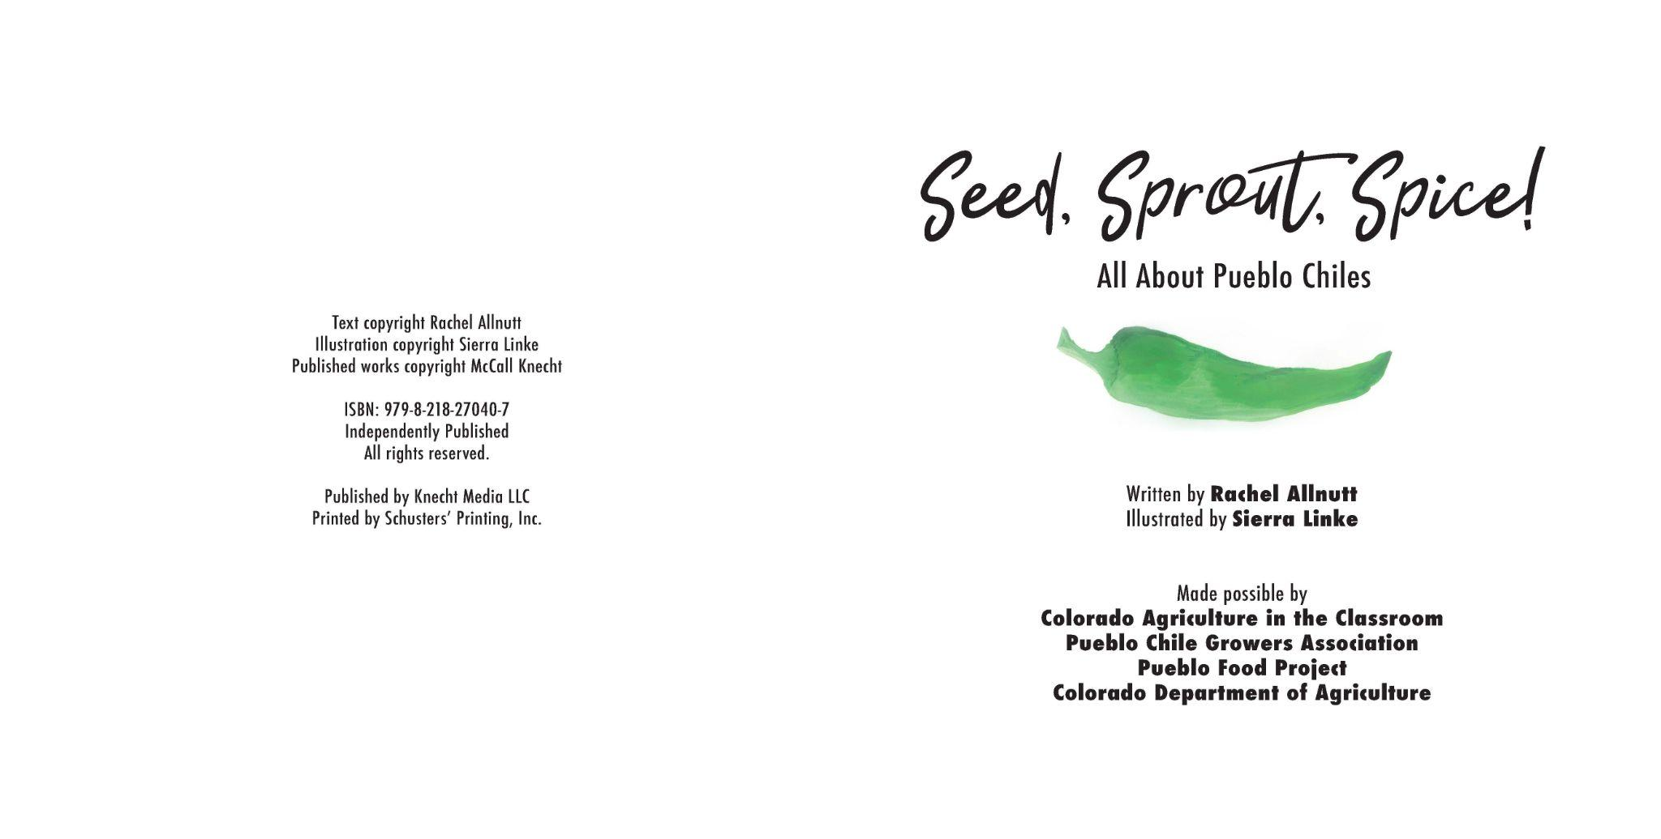

Slide 14
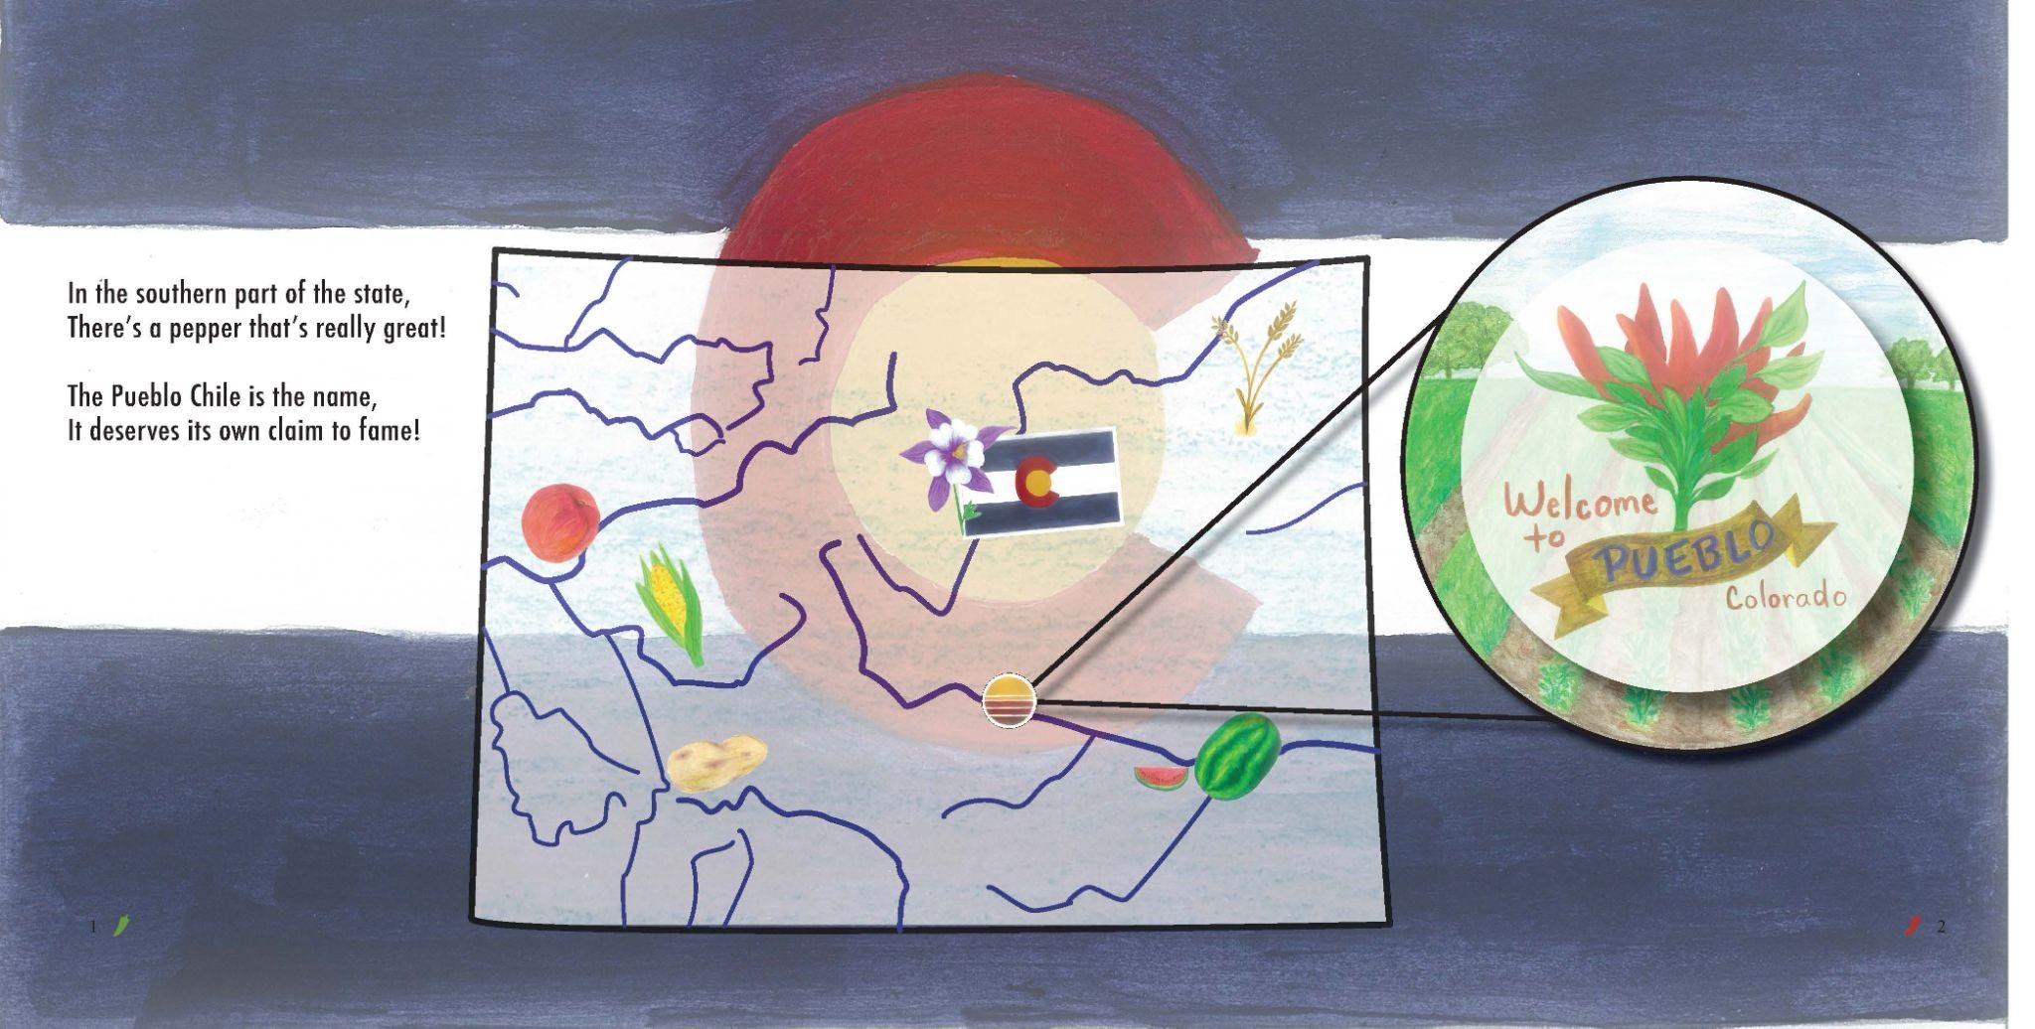

Slide 15
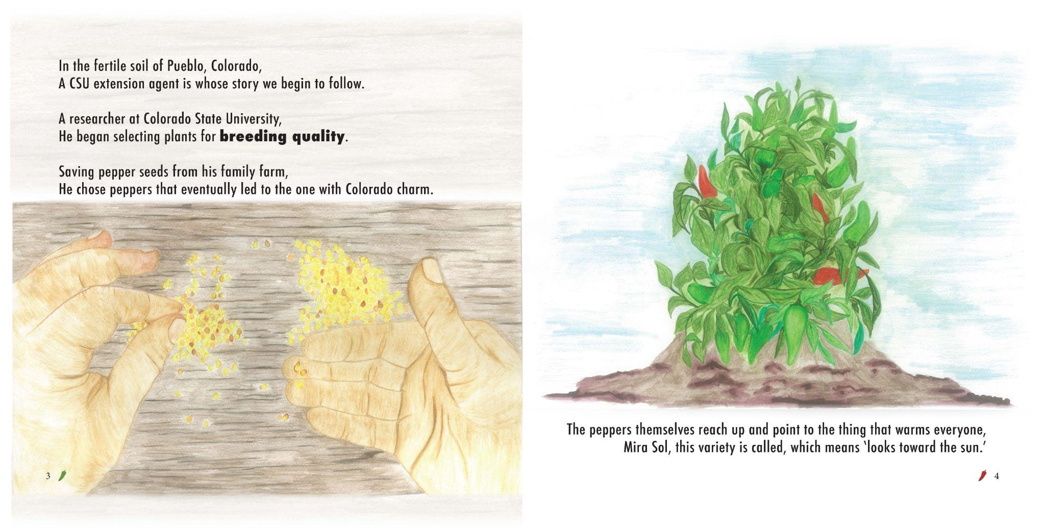

Slide 16
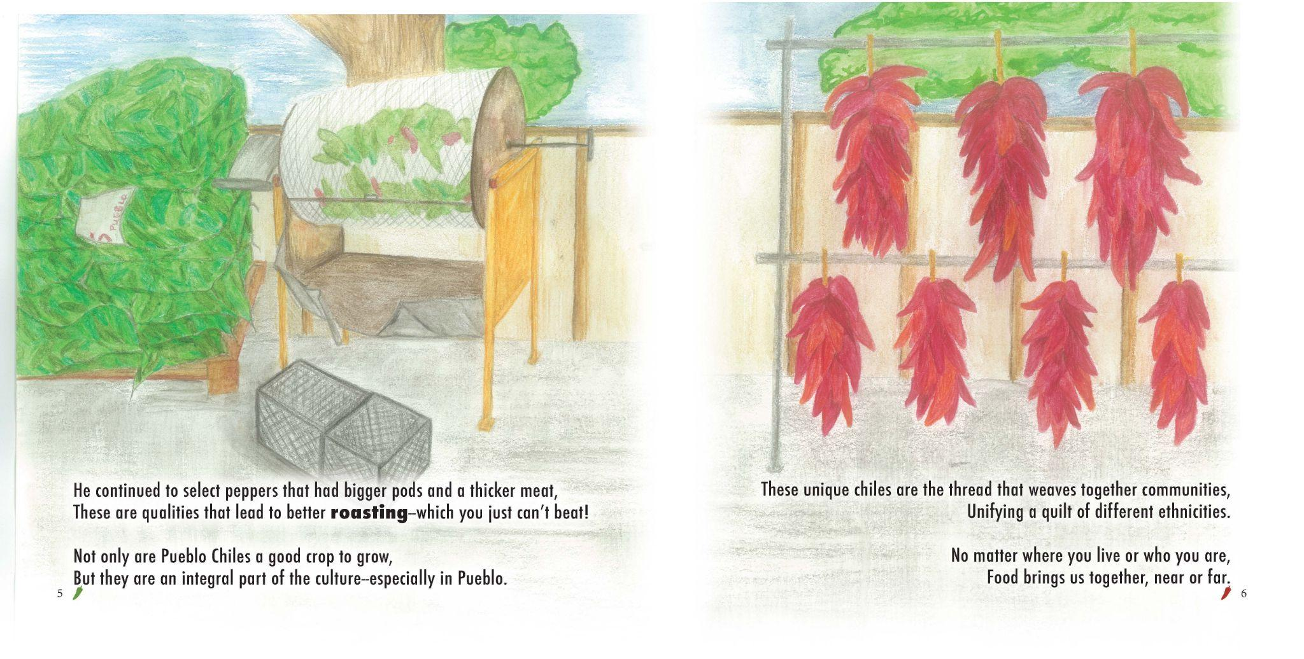

Slide 17
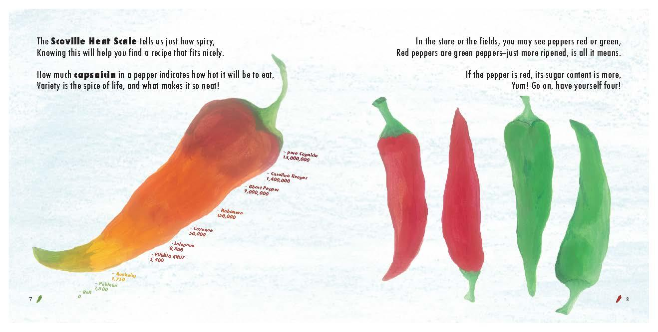

Slide 18
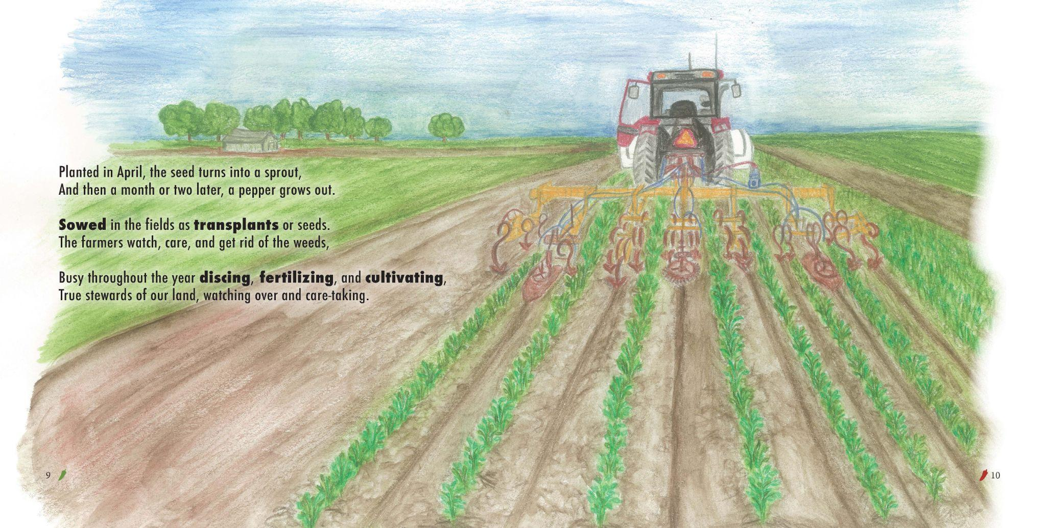

Slide 19
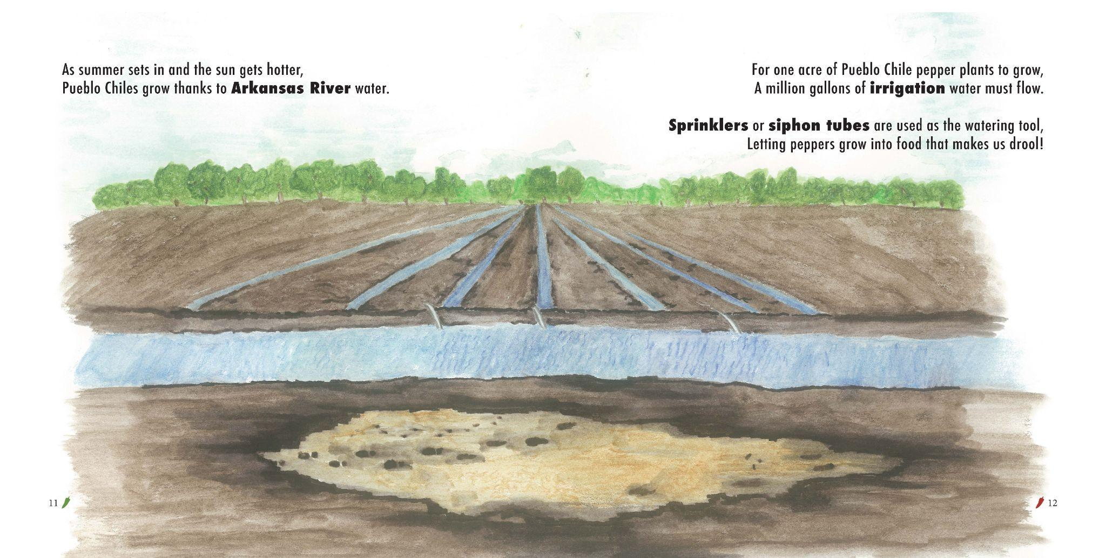

Slide 20
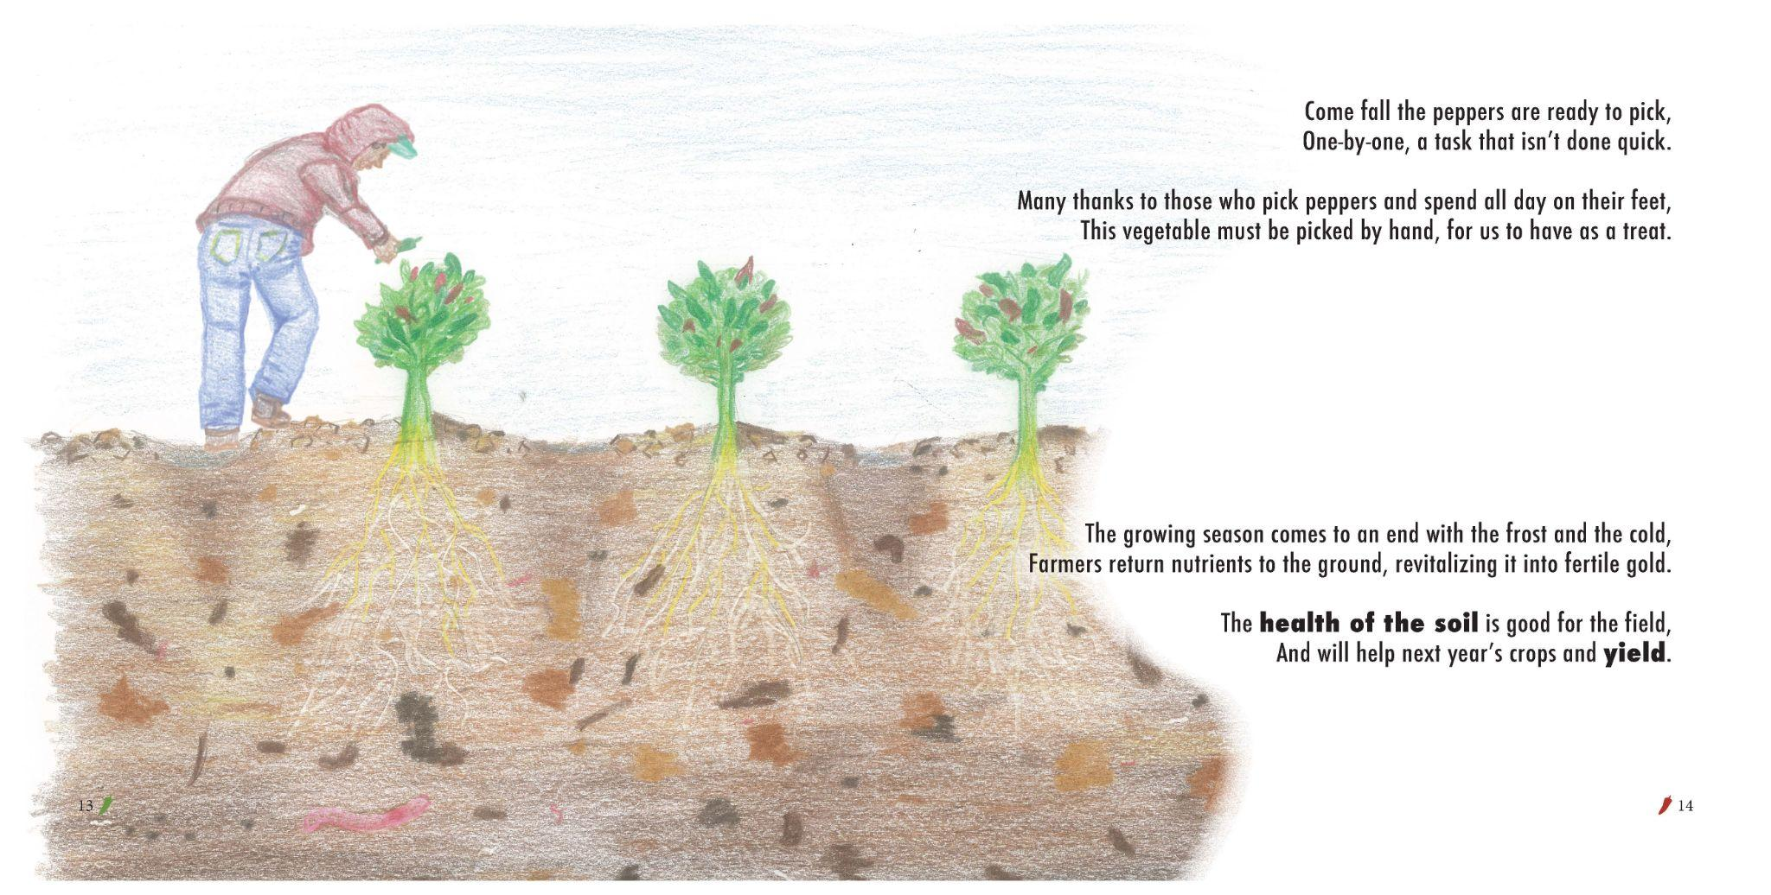

Slide 22
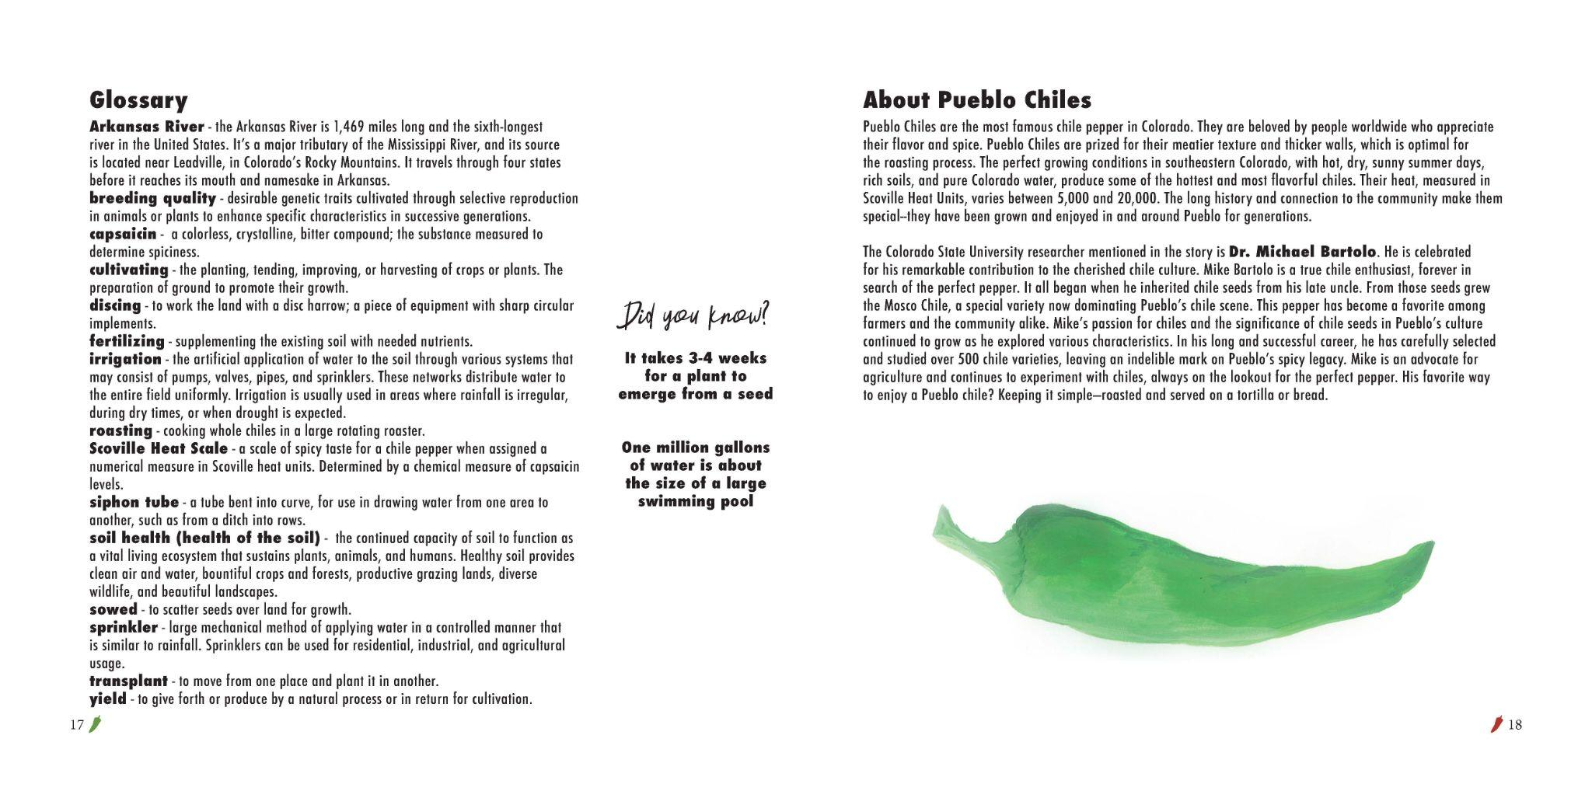

Slide 24
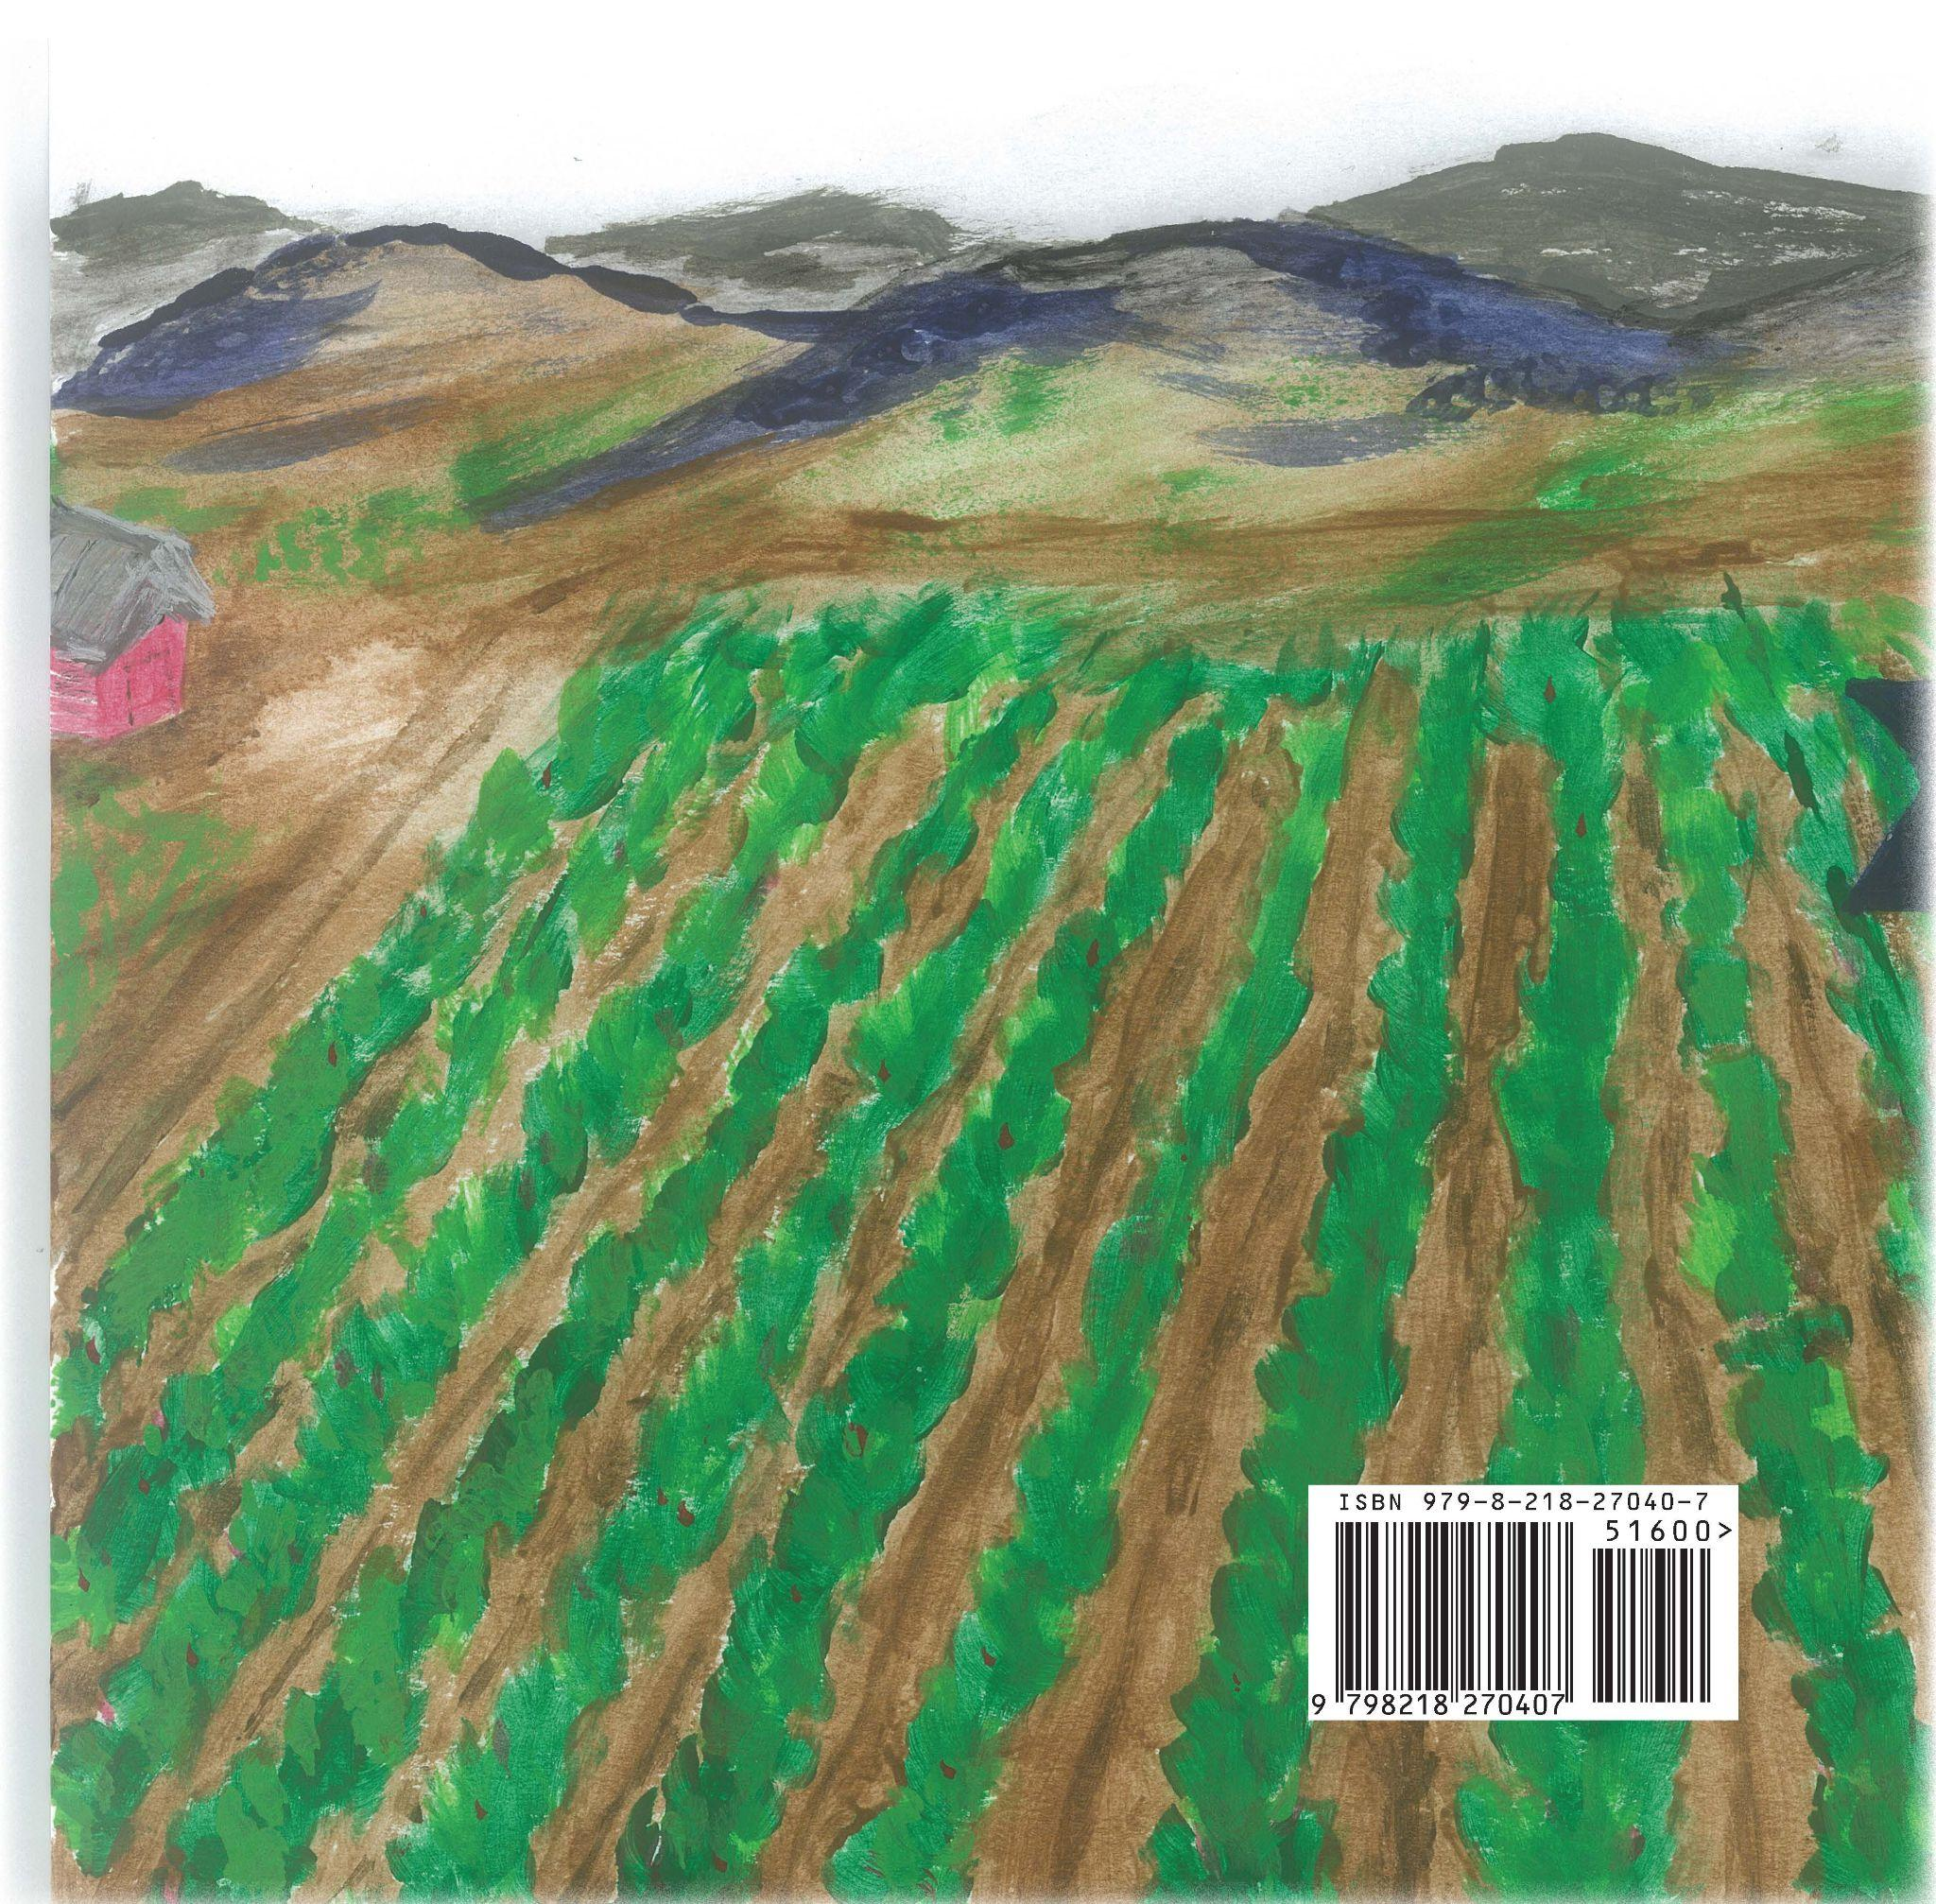

Slide 25
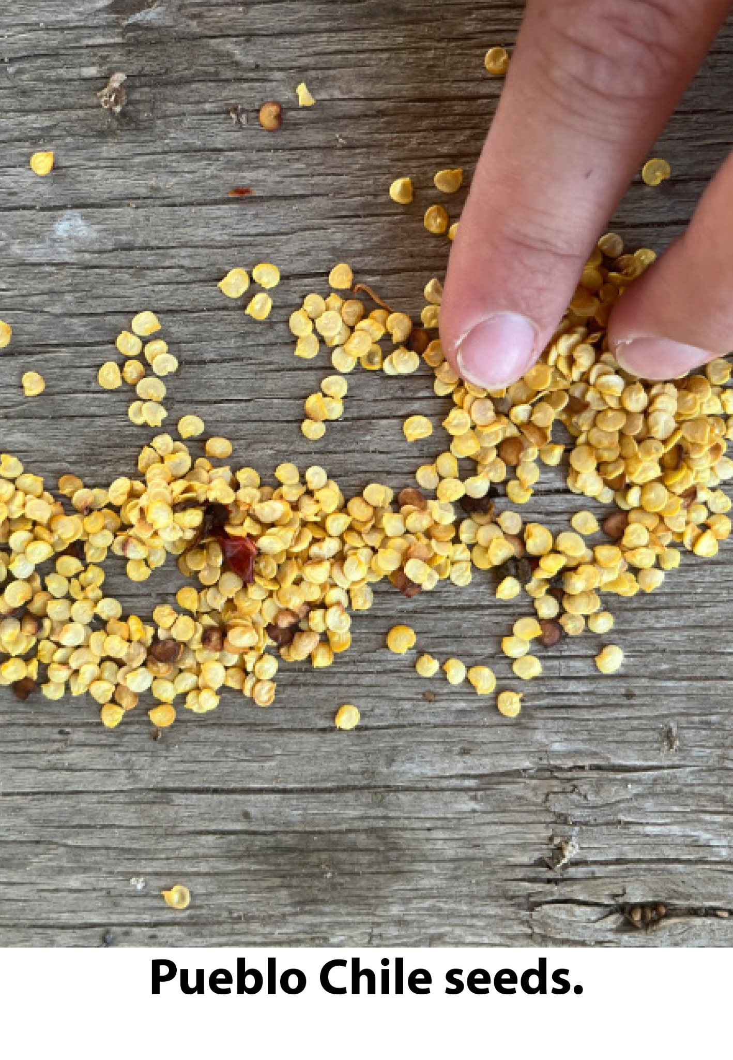
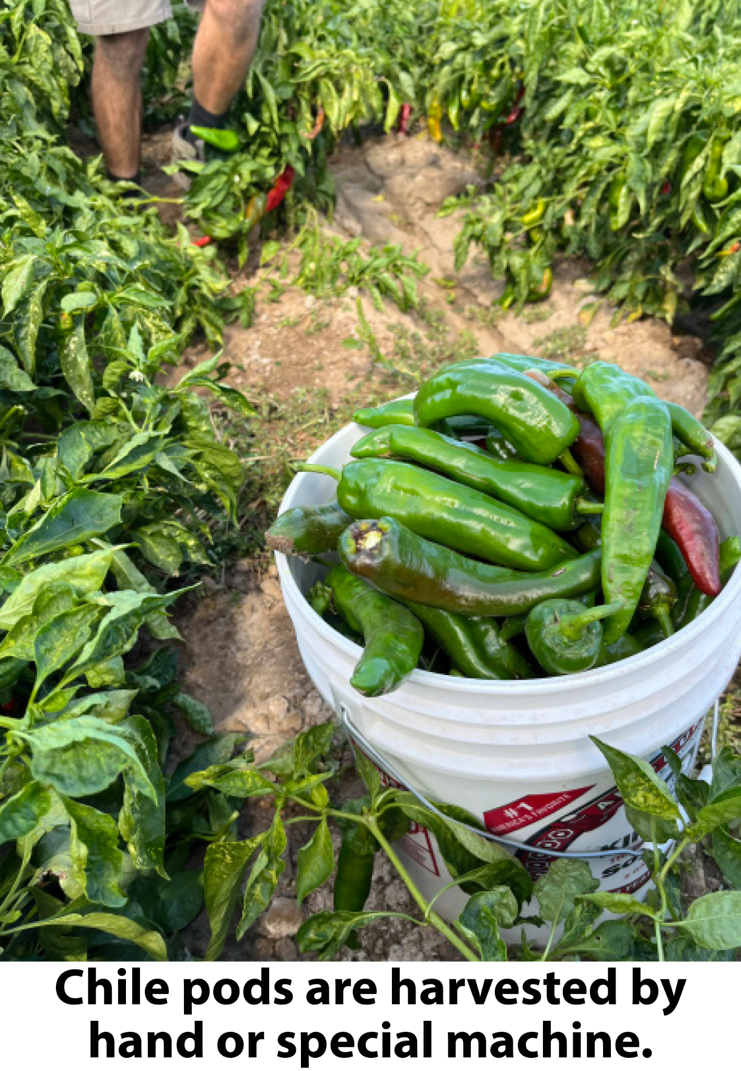
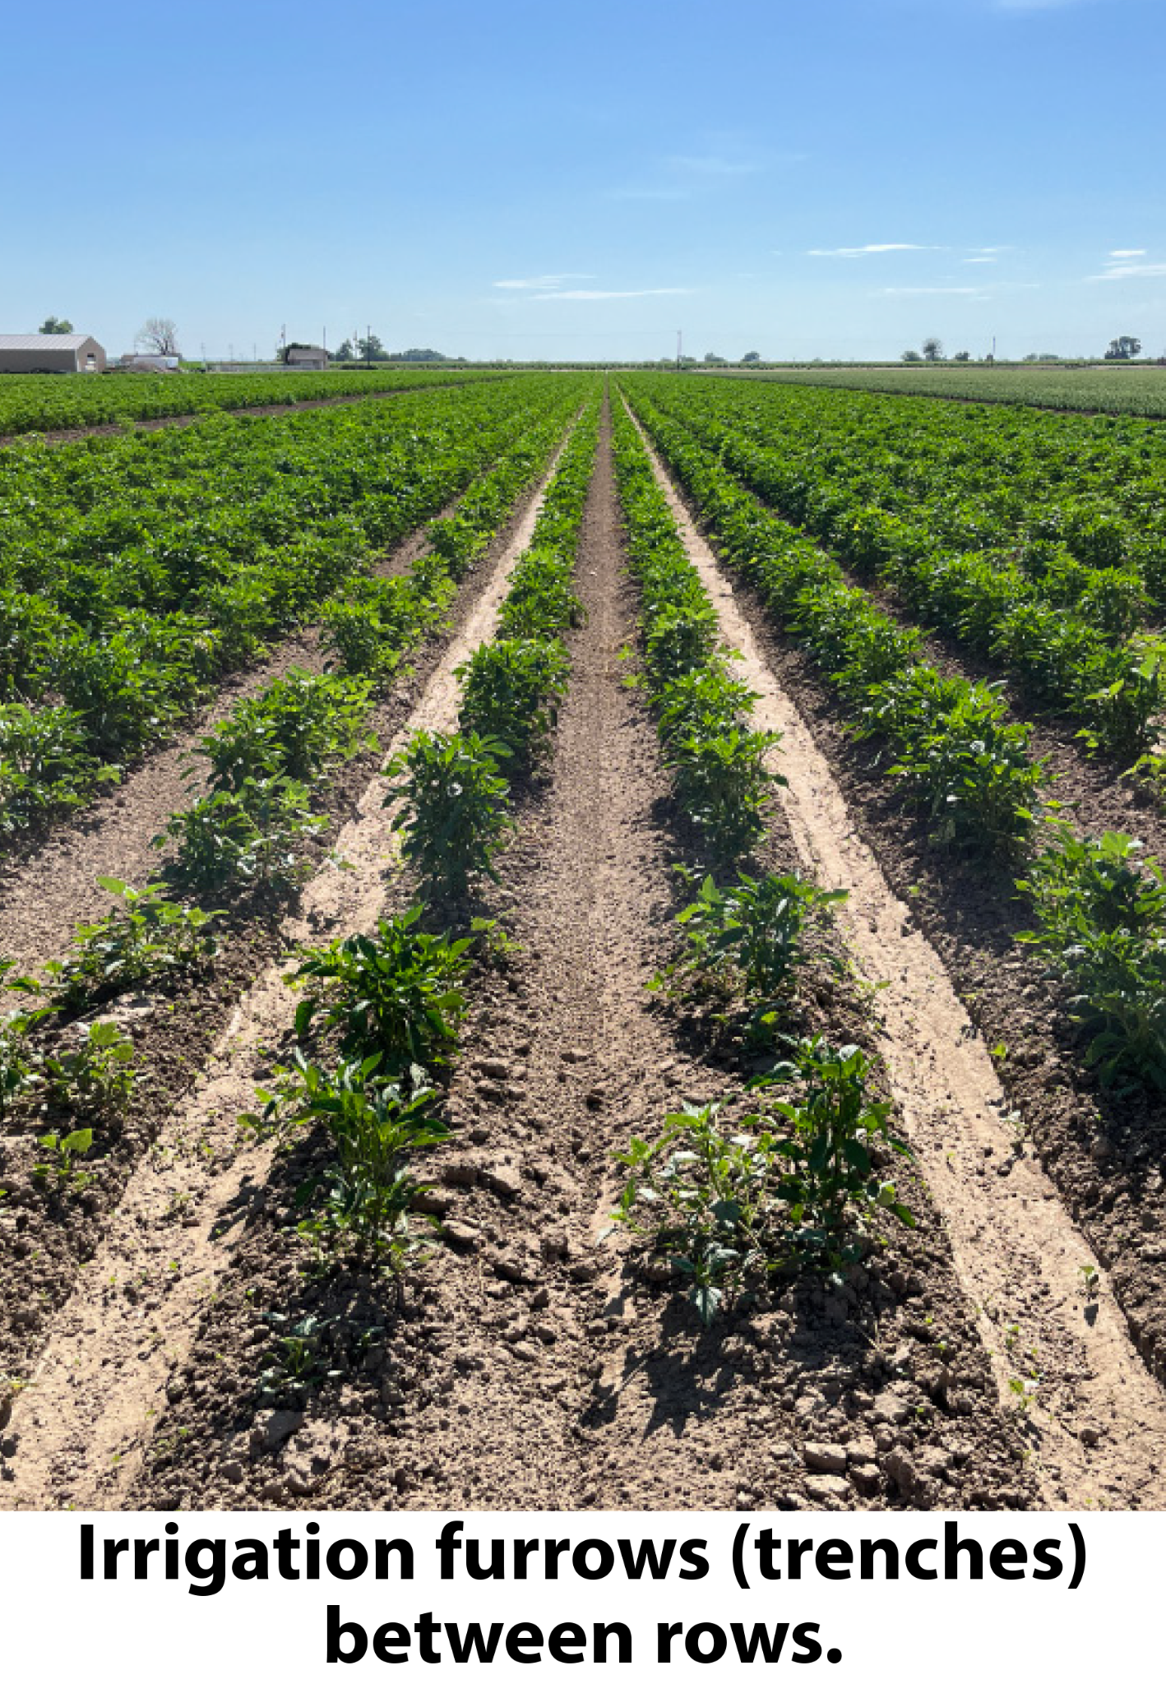
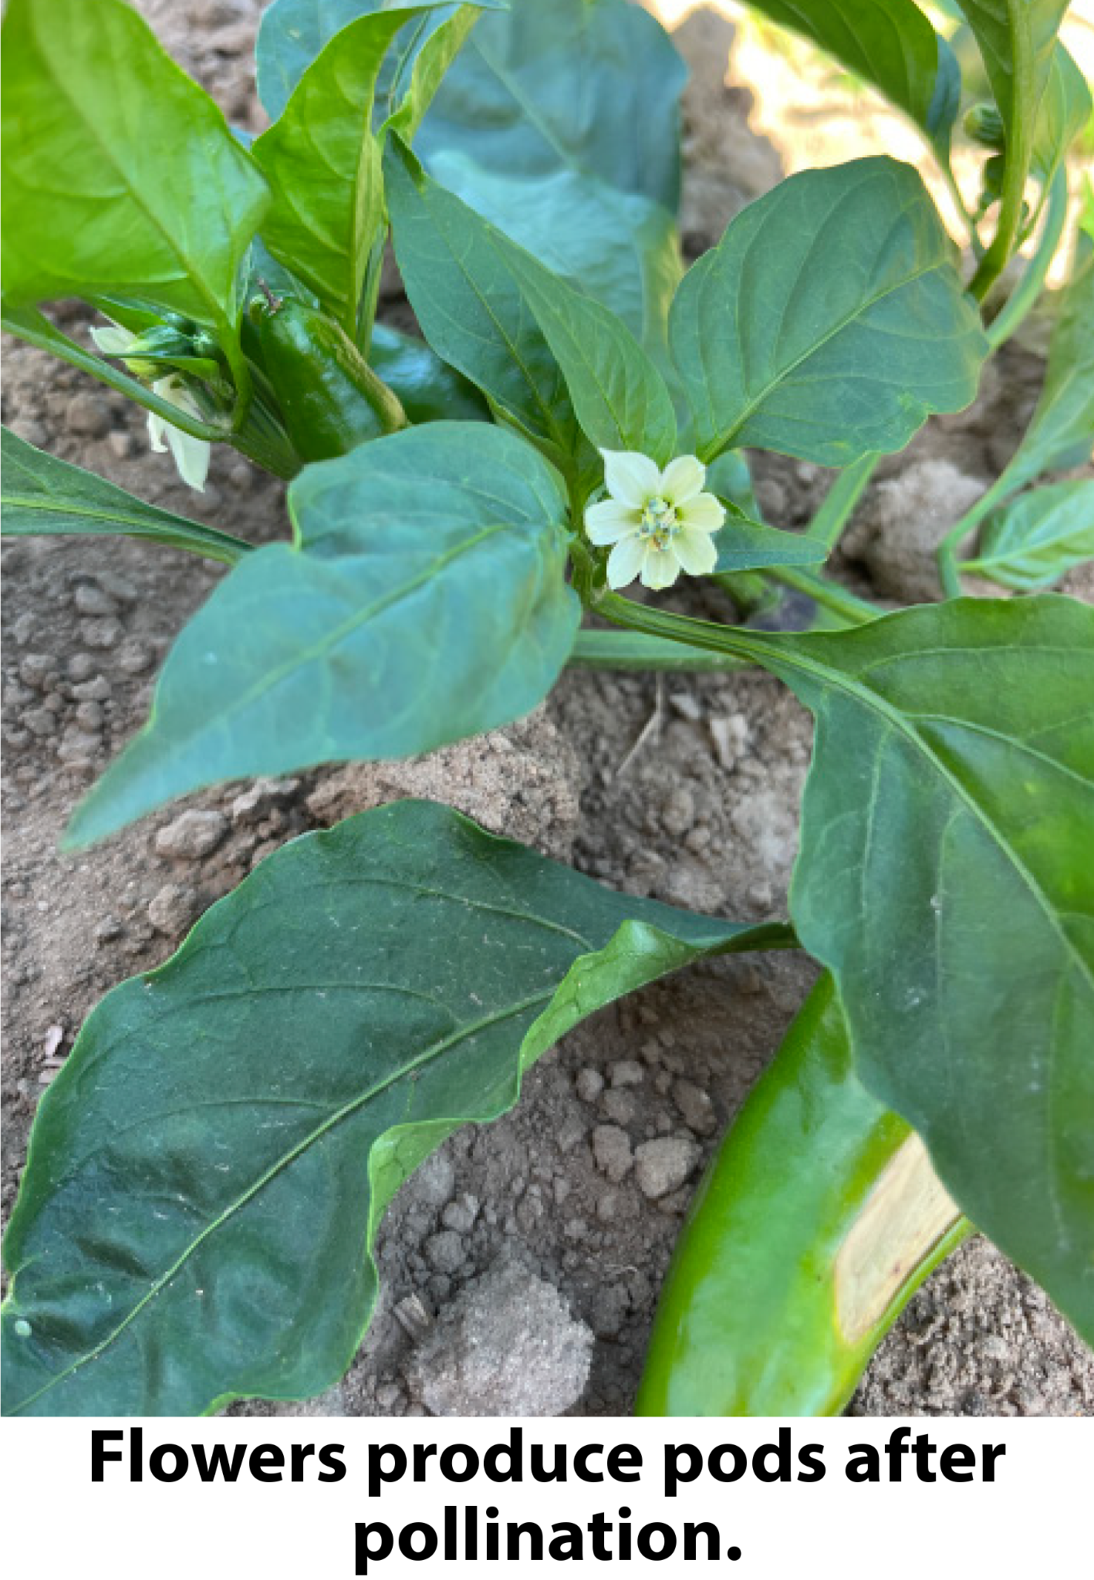
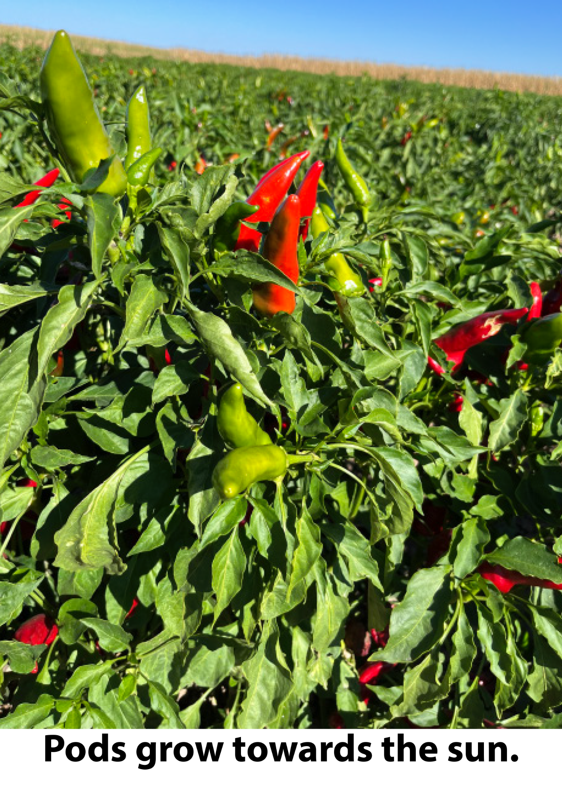
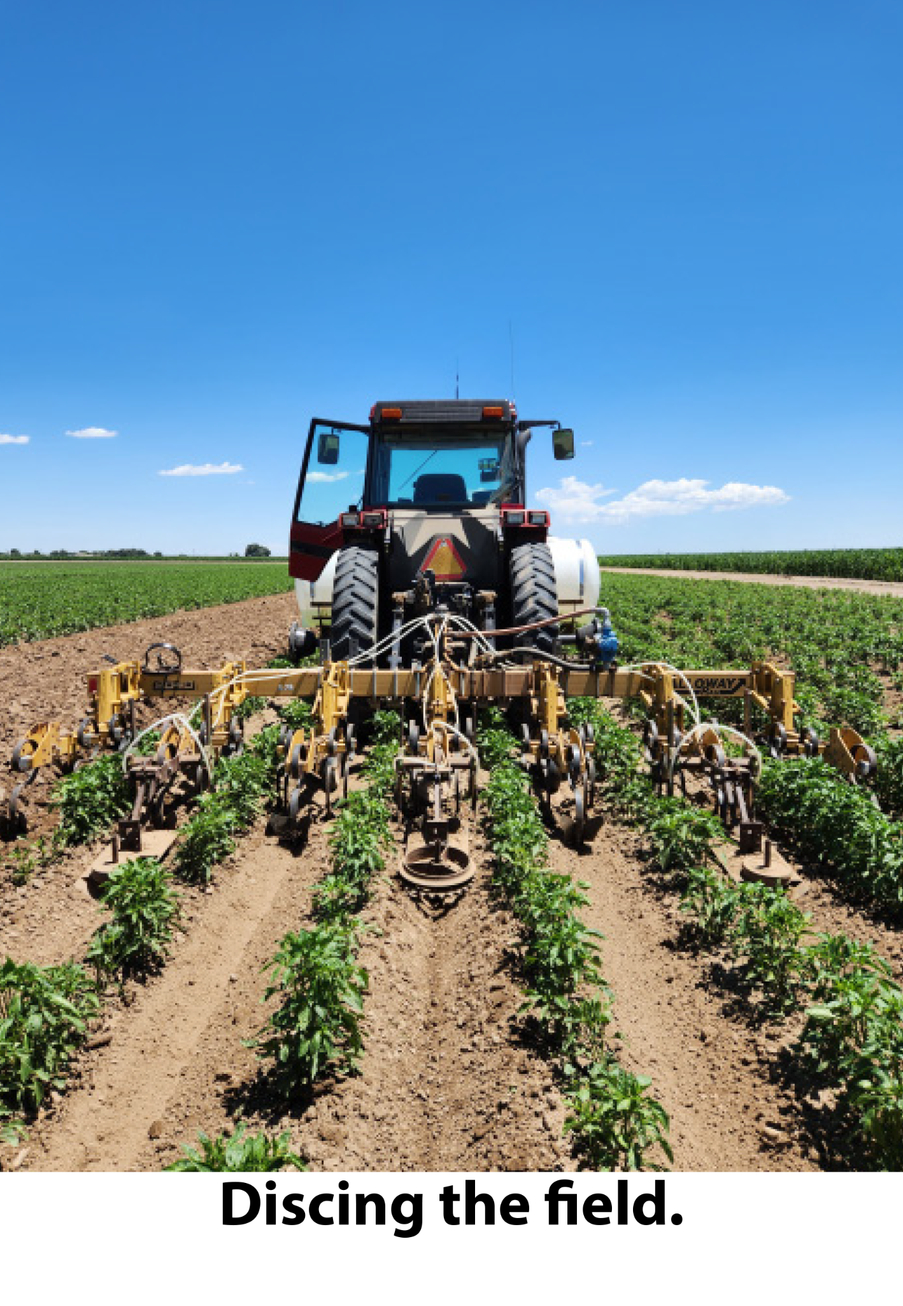
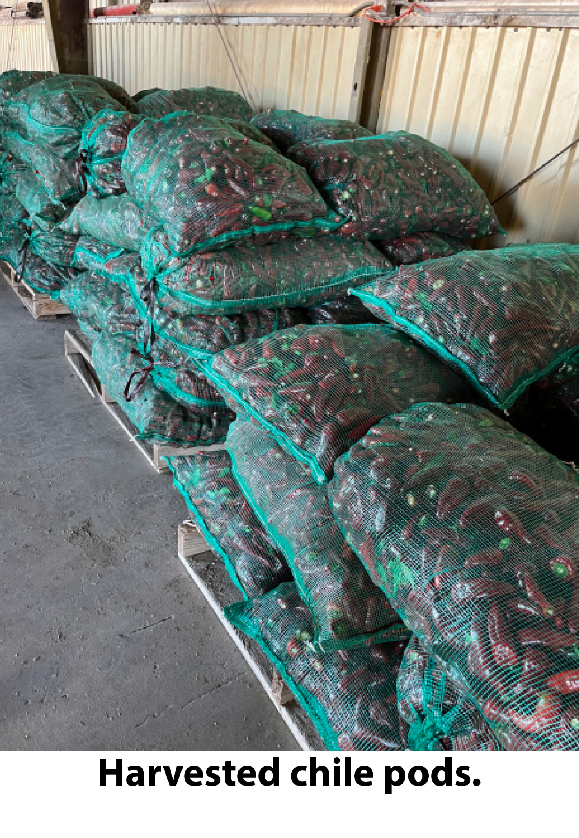
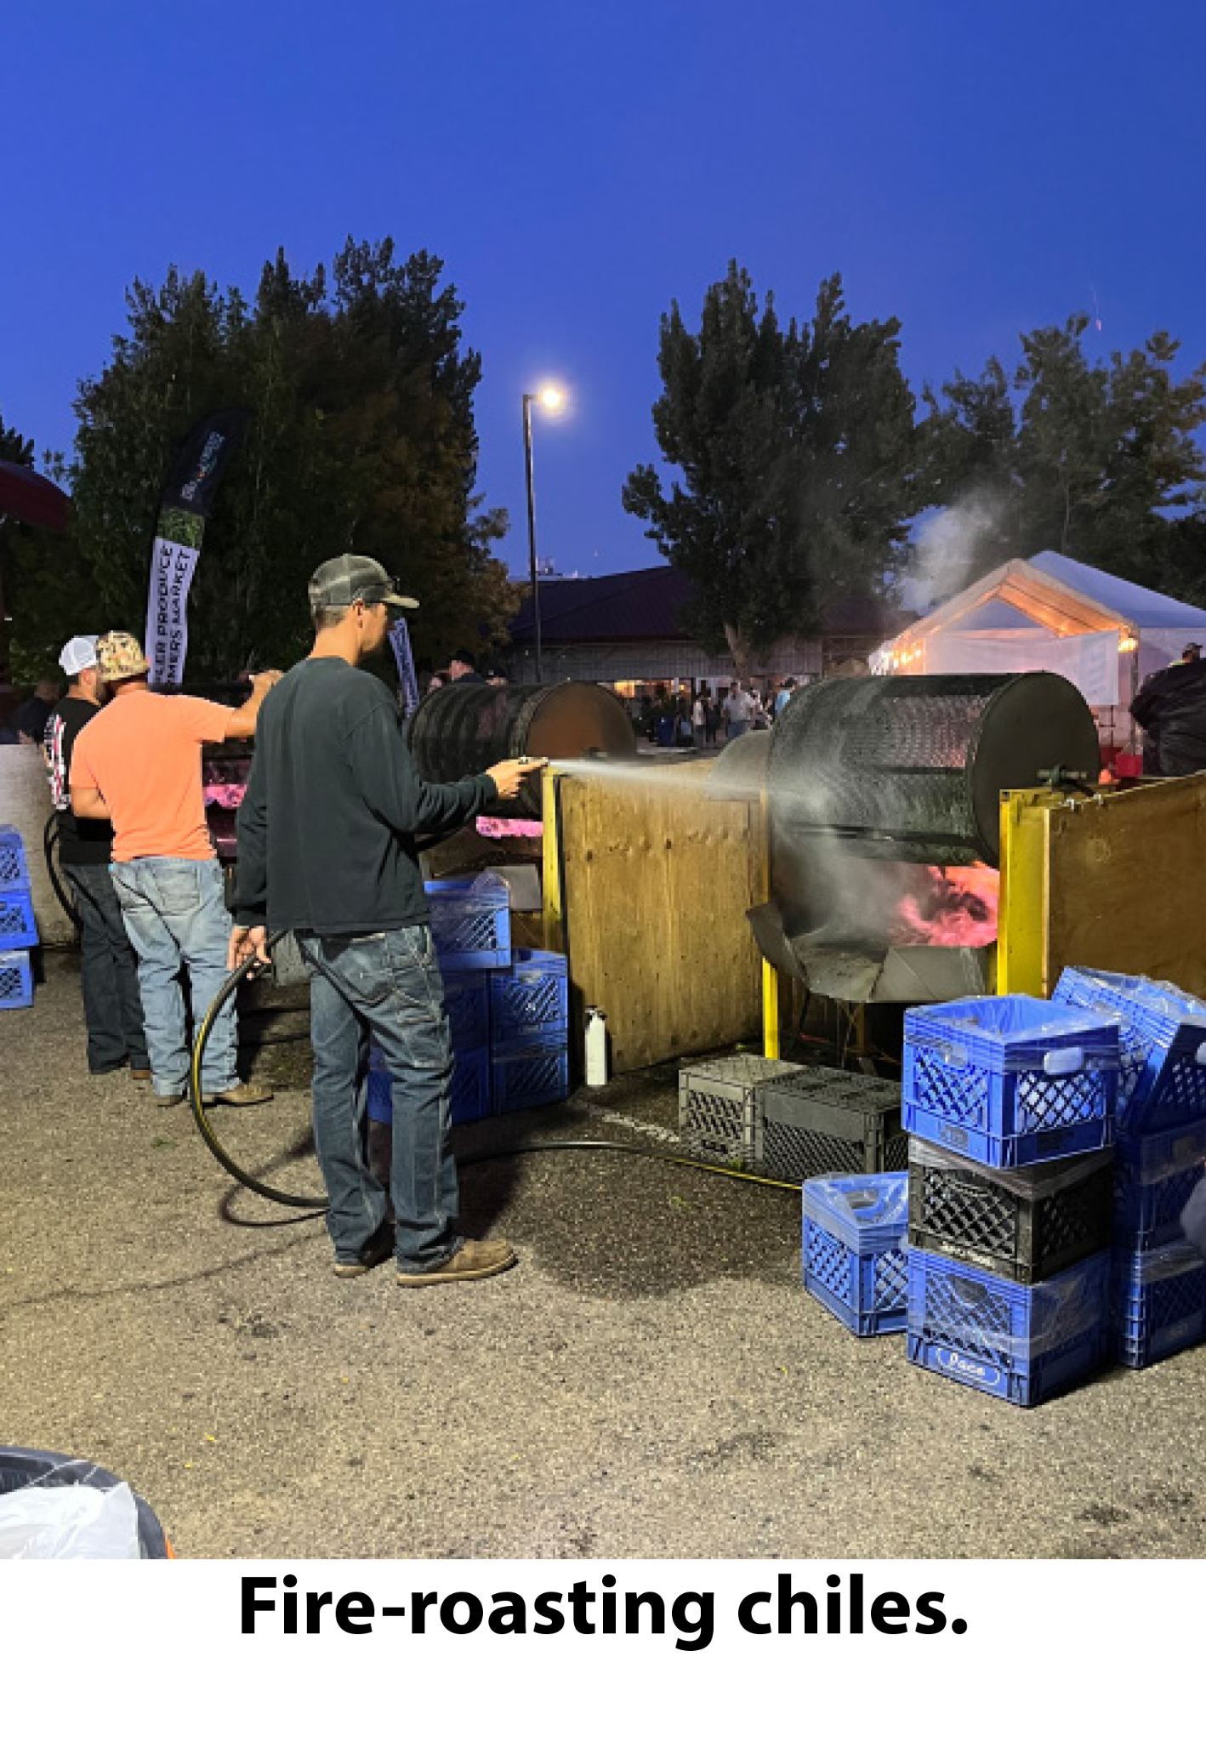

Slide 26
Reflection Questions:
What did you notice in the story?
What did you wonder about the story?
What makes Pueblo Chiles special and unique?
How were Pueblo Chiles developed?
How do farmers grow Pueblo chiles?
What do you remember from the story about water?

Slide 27
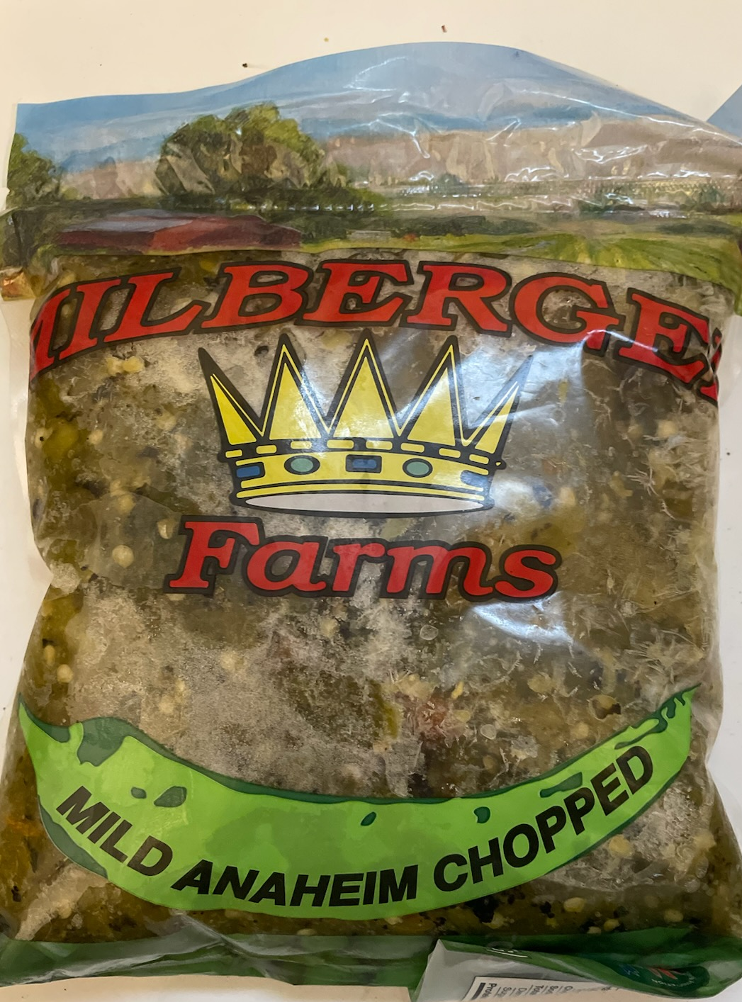
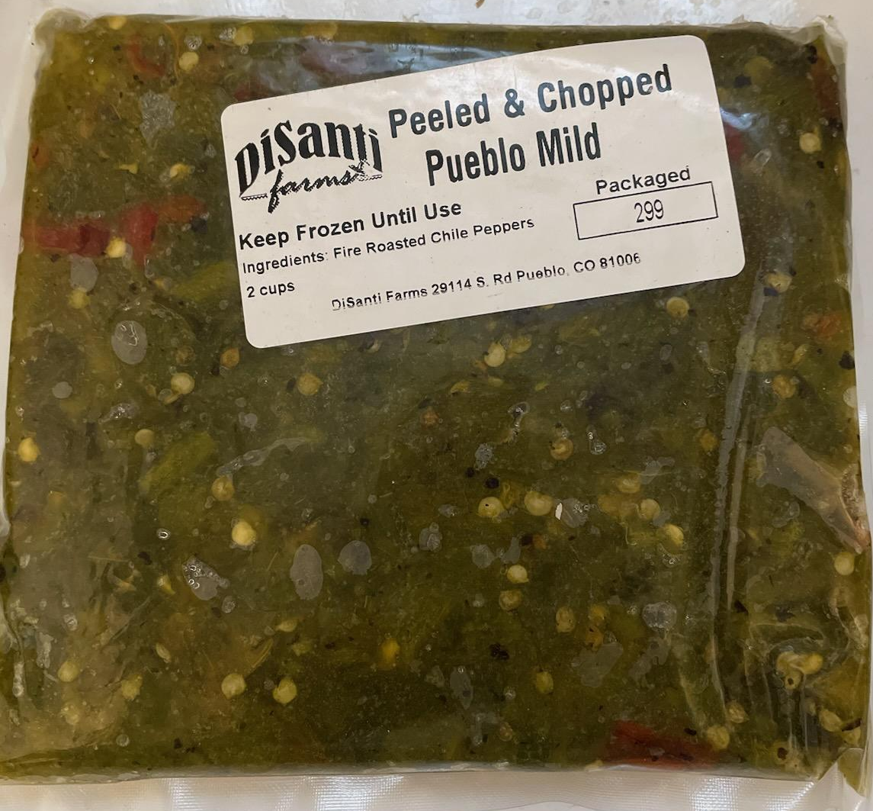
Try It! - Pueblo Chile Tasting Experience
Enjoy a sample of Pueblo Chiles. The chiles have been purchased from several Pueblo Chile growers including DiSanti Farms, Millberger Farms, Crites Produce, Mauro Farms, and Musso Farms. The chiles were grown, harvested, washed, roasted, packaged, and frozen, in accordance with proper food handling and retail procedures by each farm.
Rules:
Wash your hands before handling food, even your own.
Wait to sample until everyone is ready.
If you don’t like it, you will have to explain why.
Complete the student worksheet.

Slide 28
Post-Test Student Question #1
Are chile peppers grown in Colorado?
Thumbs UP for YES!
Thumbs Down for NO!
Thumbs Sideways for NOT SURE!
Teachers and/or Volunteers, please record student responses.

Slide 29
Post-Test Student Question #2
Did you learn something about Pueblo Chiles?
Thumbs UP for YES!
Thumbs Down for NO!
Thumbs Sideways for NOT SURE!
Teachers and/or Volunteers, please record student responses.

Slide 30
Post-Test Student Question #3
Would you eat more Pueblo Chiles in the future?
Thumbs UP for YES!
Thumbs Down for NO!
Thumbs Sideways for NOT SURE!
Teachers and/or Volunteers, please record student responses.

Slide 31
Post-Test Student Question #4
Are Pueblo Chiles an important crop for Colorado Agriculture?
Thumbs UP for YES!
Thumbs Down for NO!
Thumbs Sideways for NOT SURE!
Teachers and/or Volunteers, please record student responses.

Slide 32
Thank you for participating!
Seed, Sprout, Spice!
All About Pueblo Chiles

