Slide 1
Lesson 1: Energy Flow

Slide 2
Plugged In
Think of five things you do each day which require energy!
Hold up five fingers to show when you are ready.

Slide 3
Learning Objectives
Explain how energy is generated
Explain how energy is distributed
Develop a model demonstrating the flow of energy from generation to use

Slide 4
Top 10 - Put them in order!
Top 10 Energy Sources
Natural Gas
Petroleum
Biomass/
Biofuel
Nuclear
Petroleum
Coal
Wind
Natural Gas
Wood
Hydropower
Solar
Coal
Geothermal

Slide 5
Top 10 Energy Sources Used in U.S.
1. Petroleum, 36% - 20pts
2. Natural Gas, 27% - 18 pts
3. Coal, 18% - 18 pts
4. Nuclear, 8% - 10 pts
5. Hydropower, 2.7% - 9 pts
6. Biomass/Biofuels, 2.43% - 8 pts
7. Wood, 1.98% - 7pts
8. Wind, 1.35% - 6pts
9. Geothermal, 0.27% - 5pts
10. Solar, 0.18% - 4pts

Slide 6
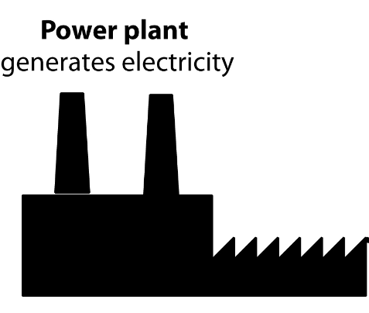
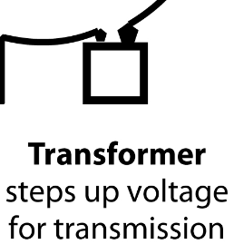
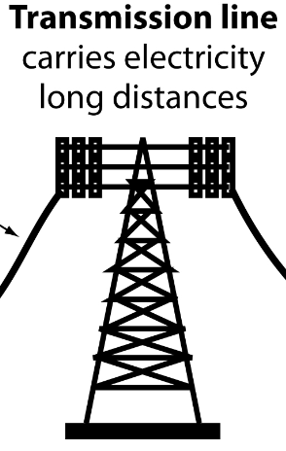
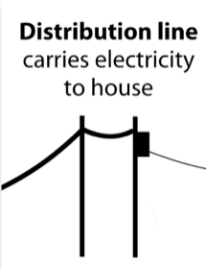
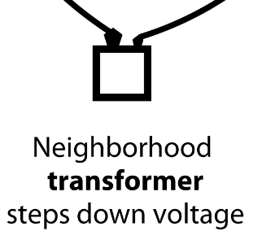
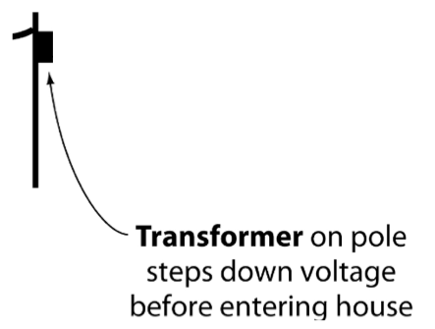
Transmission Card Challenge
2
3
1
6
Draft Graphics from www.need.org
5
4

Slide 7
Build a Mini-Model
Fit on a 3x5 index card
Show 7 major steps in energy transmission
Have a 3D component
Be ready to share the process using your model!

