Slide 1
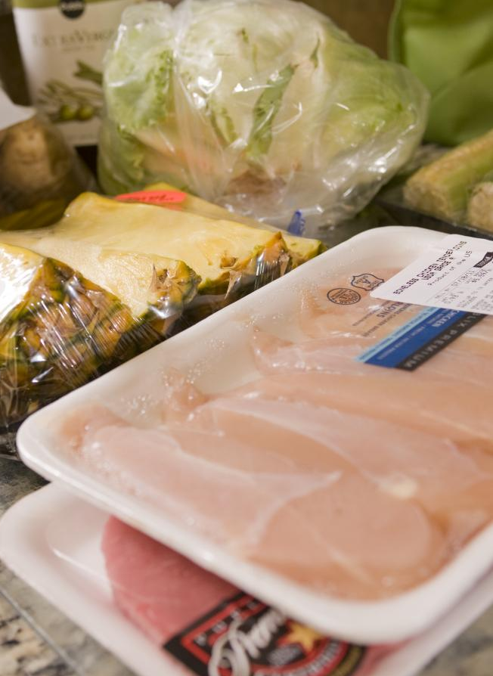
FOOD SAFETY SLEUTHS
Photo Credit CDC Amanda Mills

Slide 2
What is a foodborne illness?
A disease carried to humans by food
Symptoms include nausea, vomiting, stomach cramps, fever, and diarrhea
Photo Credit CDC

Slide 3
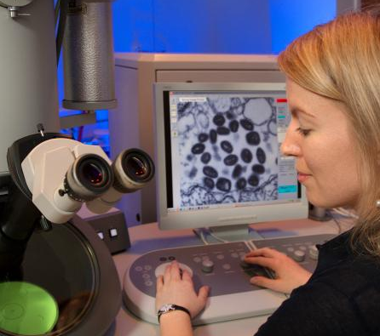
What causes foodborne illness?
Mostly caused by pathogenic microorganisms
Bacteria
Viruses
Parasites
Often spread by mishandling food. Invisible to the naked eye.
Photo Credit CDC/ Cynthia Goldsmith

Slide 4
Bacteria
Single-celled organisms.
Most are harmless but those that cause illness are pathogenic.
Thrive in warm, damp places. Can double in number every 10 – 30 minutes.

Slide 5
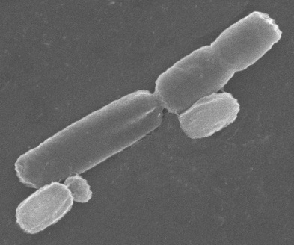
Bacteria
Bacteria are classified by 3 main shapes:
Bacillus – rod shape
Cocci – spherical shape
Spirilla – spiral shape

Slide 6
Bacteria
One example of a type of bacteria that commonly causes illness is Salmonella
Sources include contaminated meat, milk, juice, cheese, and veggies. Reptiles, amphibians, and birds can also carry the bacteria.
Symptoms – diarrhea, fever, stomach cramps, vomiting for 4-7 days.

Slide 7
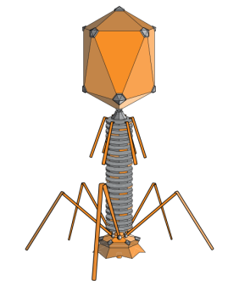
Viruses
Viruses - smallest forms of life. Cannot reproduce outside living host cell.
Hepatitis A is an example of a virus that causes liver disease.
Sources – raw or undercooked shellfish, raw produce, contaminated water, fecal material from infected person
Symptoms – diarrhea, dark urine, jaundice, fever, nausea, loss of appetite.

Slide 8
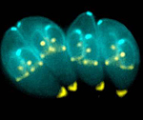
Parasites
Parasites - tiny organisms that require a host to live. Example of a parasite that affects many people in the U.S. is Toxoplasma gondii.
Sources – contaminated raw meat, cutting boards, feces from infected cats, contaminated water
Symptoms – enlarged lymph nodes, headache, muscle pain, fever, sore throat, eye disease

Slide 9
PREVENTION
Prevent foodborne illness from viruses, bacteria, and parasites by:
Clean: Before eating or preparing food, wash hands for at least 20 seconds, utensils, cookware, and surfaces with soap and water. Rinse fruits and vegetables with water.
Separate: Use separate cutting boards and plates for raw produce, meat, poultry, seafood, and eggs.
Cook: Cook food to at least 140˚F. The danger zone at which bacteria multiply rapidly is from 40˚F to 140˚F
Chill: Refrigerate perishable foods within two hours or less. Set refrigerator between 40˚F and 32˚F, and freezer 0˚F or below. Thaw or marinate foods in the refrigerator or microwave. Throw food out that is past its expiration date!

Slide 10
Now you know what it takes to be a food safety superstar
Clean
Separate
Cook
Chill
Write a song or rhyme about the food safety steps.

